Slide 1
Research Data Action Group at Warwick
Redefining Engagement – The Mercian Collaboration Conference 2022
Dr Ishwar Kapoor, Research Data Officer, The Library
9 September 2022

Slide 2
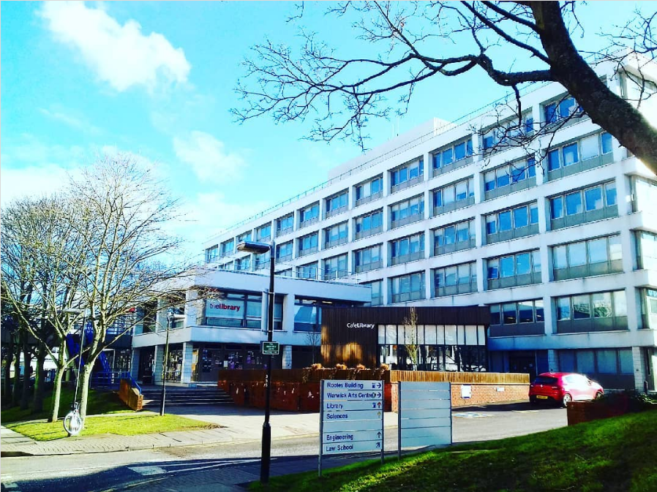
Who am I?
The University’s Research Data Officer at the Library
Provide support to university members in planning, managing and preserving their research data in the light of the University and funding body policies and to advise on all aspects of open research data (including its reuse)
Before the above role, PhD and researcher in Engineering at Warwick (WMG) specialised in lightweight automotive
The Library, photo taken in February 2018 @ishwarkapoor

Slide 3
Security and Information Management
Legal and Compliance Services
Data Protection, GDPR
IPR, Copyright
Data Retention policy
LEGAL SUPPORT
IT Services
E-repositories
Data sharing and storing options
WRAP development
Software procurement
INFRASTRUCTURE SUPPORT
RESEARCH ETHICS SUPPORT
Research & Impact Services
Research ethics
Data Management Plan
Funder requirements
Research Data Officer
FRONTLINE
SUPPORT
Organisational Development
Doctoral College
Student Opportunity: Skills
Academic Departments such as Big Ws (WMG, WBS, WMS)
Academic Support Librarians
Modern Records Centre (MRC)
Community Engagement
Students and RAS research data support requirements
POLICY SUPPORT
Governance
Secretary of Open Research Group
Promote awareness of Open Research
Understanding of Open Research issues
Recommendations to Research committee on policy, services and requirements such as Research Data Road Map, Block Grants etc.
Research support
University members (students and staffs)

Slide 4
EUTOPIA Alliance – RDM

Slide 5
Outline
Introduction to Research Data
Introduction to Research Data Action Group
Milestones
Please make this session as interactive as you wish.

Slide 6
Introduction to Research Data

Slide 7
Research Data?
The smallest building blocks of research, created, observed or collected for analysis to test a research hypothesis
Types of Research data
Analogue (hard copy, surveys, questionaries, lab notebooks etc.)
Primary (generated by the project, for example measurement reading or patient interview)
Qualitative (image etc.)
Digital (excel spreadsheets, audiotapes, videotapes etc.)
Quantitative (student’s essay marks etc.)
Secondary (collected from other sources, for example historical records of weather pattern in between 1940 to 2000)
Born digital
Made digital

Slide 8
Research Data Management (RDM)?
Research data management (RDM) means the storage, curation, preservation and provision of continuing access to analogue and digital research data
Easier to conduct research
creating backups of your work and controlling who has access to them
choosing file formats that can be opened easily in the future
RDM includes activities such as…
describing methodology and keeping track of versions of files

Slide 9
Plan starts here!
Research Data Lifecycle
Where are you?
Data created/collected/
observed
What questions need to be thought about at each stage?
Data creation - What data will you produce?
Data reused
Data processed
Data processing and analysis - How will you look after your data once it has been created/gathered?
Data archived
Data analysed
Data preservation and access - Can you/others understand the data?
Data reuse - Who owns the data? Where will the final data be stored?
Data published
Credits Data management plans, The Library, The University of Warwick, UK

Slide 10
RDM: Current risks and challenges
Compliance. UKRI funders expect HEI to be monitoring against their policies. Threat of withdrawal of funding – potentially at institutional level - if a funded researcher is non-compliant with a specific policy. Currently very difficult to assess.
Data loss. Research data at risk if not suitably secured.
Data leakage. Inadequate planning could lead to IPR risk, GDPR fines and reputational loss.
Research validation. Reputational risks if papers have to be retracted due to lack of data.
Funding opportunities missed due to poor or inadequate Data Management Plans.
Incomplete knowledge by institution of a key asset. Size, location and nature of research data currently held by the University is difficult to identify or quantify.
Wasted researcher time and effort in inefficient data handling systems, data re-creation and missed opportunities of data re-use.

Slide 11
Introduction to Research Data Action Group (RDAG)

Slide 12
Research Data Action Group (RDAG): Who are we?
The members of RDAG are from different administrative/academic services specialised in data support to students and staffs across the University:
The Library (Scholarly Communications and Modern Records Centre)
Information and Digital Group (IDG)/IT Services (ITS)
Research & Impact Services (R&IS)
Security and Information Management (SIM)
Academic Departments/ Research Technology Platforms (RTPs)

Slide 13
RDAG: Aims
Ensure researchers are suitably informed and resourced to:
Enable RDM best practice
Safeguard research integrity
Meet funder requirements
Information security expectations

Slide 14
Milestones

Slide 15
RDM: University of Warwick Roadmap (2022 - 2026)
The RDAG has collaboratively worked on the 6 sub-groups of the RDM Roadmap (2022 – 2026) to put forward the RDM Roadmap objectives into action:
The University/funder policy
Data management planning
Skills training & consultancy,
Data infrastructures
Data submission/cataloguing
Publishing and digital preservation

Slide 16
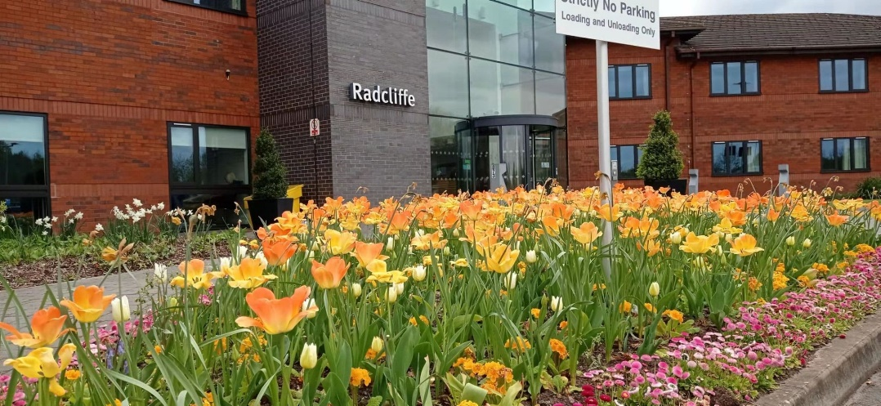
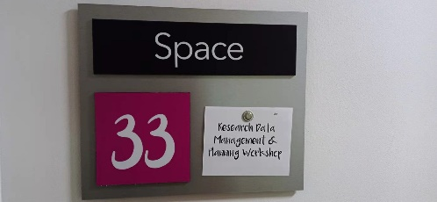
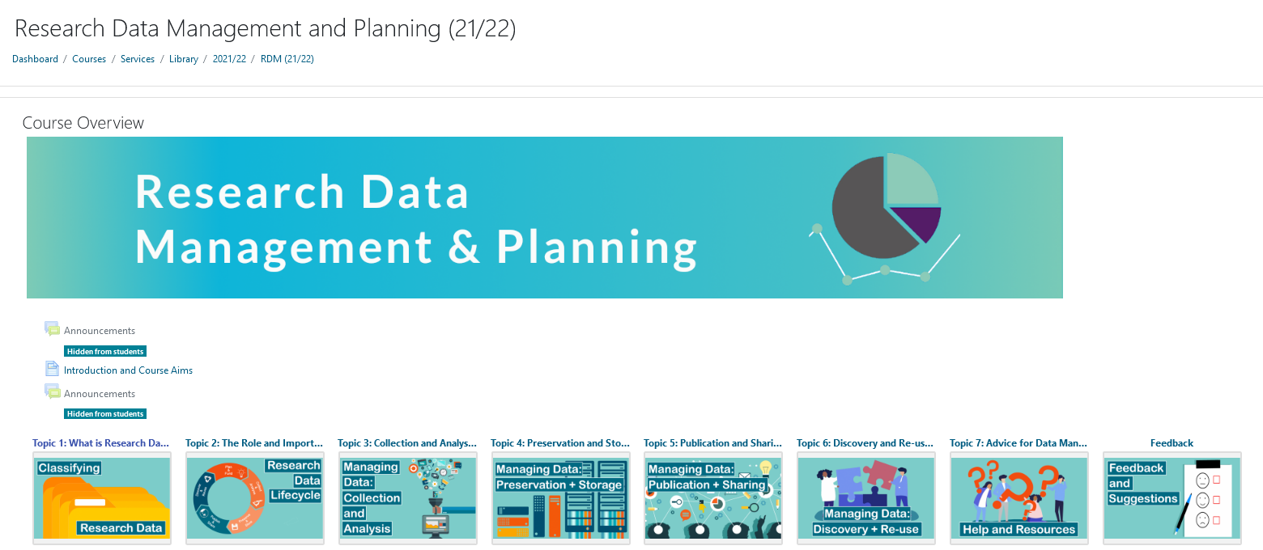
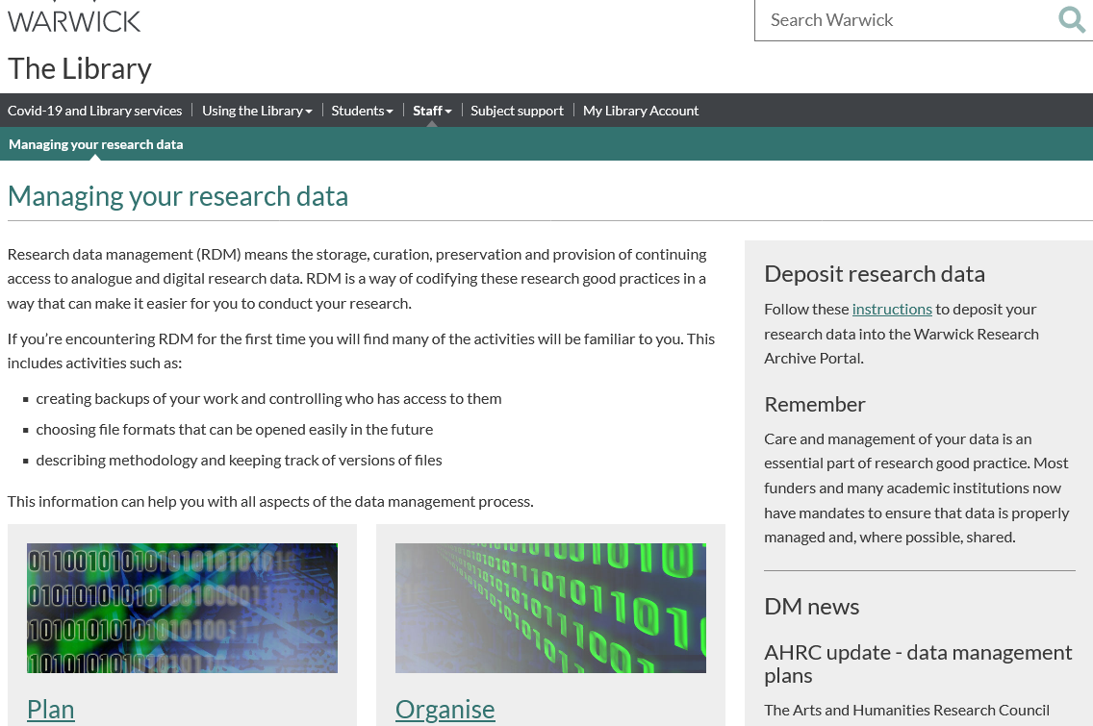
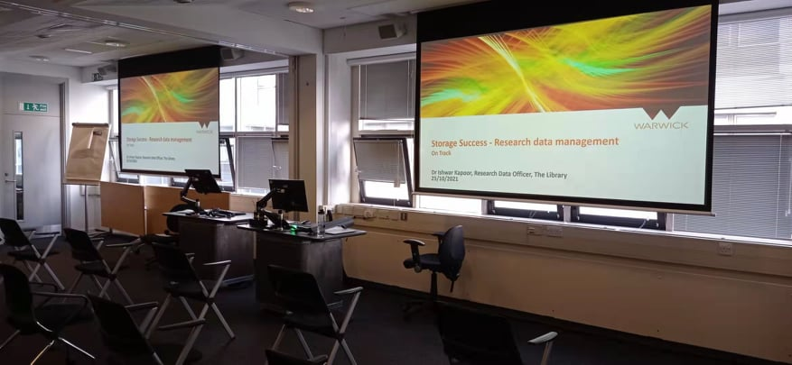
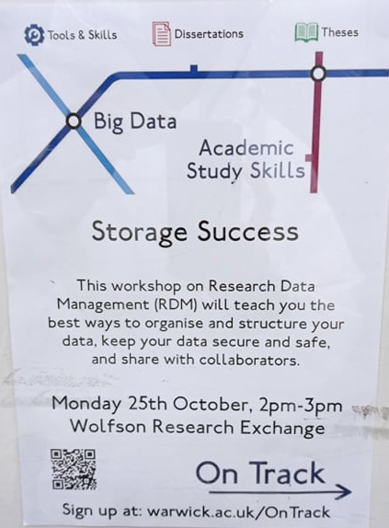
RDM: Where are we?
At Warwick, basic Research data management (RDM) systems are in place: policy, repository, basic training, basic advocacy

Slide 17
As a member of the University’s Research Ethics Committees (BSREC and HSSREC)…

Slide 18
Researchers RDM awareness falls into three categories
Researchers are aware of the best practices of RDM and have followed proper guidelines while preparing the RDM section of their ethics application
Researchers have a good basic awareness of research data good practice but have not had to engage with research data management in a formal way, such as through the production of a DMP for a funder. There may be some missing information on the RDM section of their ethics application, including data file type and size, data retention periods etc. These researchers would benefit from a short discussion with the Research Data Team to guide them through the various data requirements. This is the most common group.
Researchers may have missed significant information about research data on the RDM section of their ethics application or not followed RDM guidelines. This might include, for example, the usage of unauthorised software or cloud services for analysis of research data (especially where personal data or special category data is involved) or lack of clarity about the methodology for data collection and analysis behind collection and analysis. The practices of this group pose the greatest risk to the University and these researchers should be referred to the Research Data service for training and discussion about their projects.

Slide 19
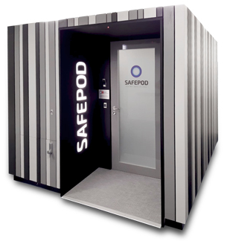
https://warwick.ac.uk/services/library/staff/research-data/safepod

Slide 20
Any questions?
Dr Ishwar Kapoor
Research Data Officer
The Library
The University of Warwick, UK
ishwar.kapoor@warwick.ac.uk
http://warwick.ac.uk/lib-researchers/research-data/

