Slide 1
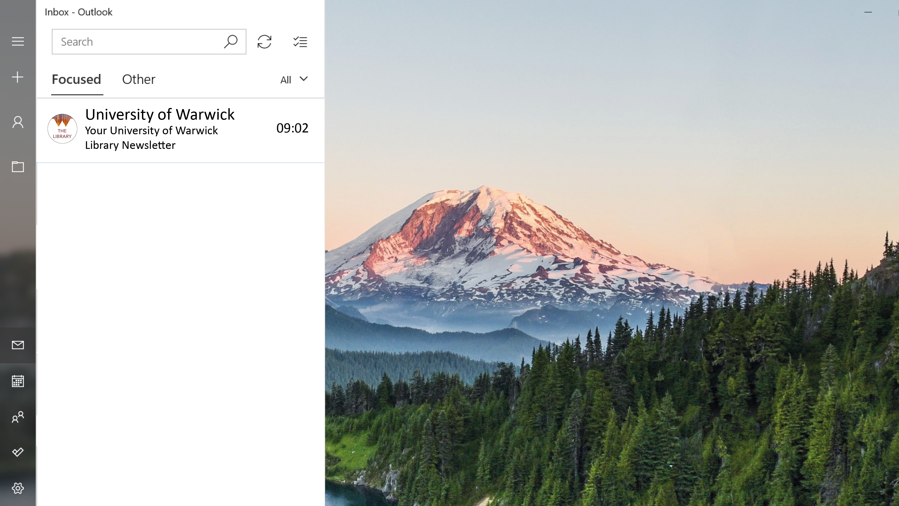

Slide 3
Dear Mercian Conference,
Presentation by Kate Courage, Sam Platts, Andy Calvert, Jade Millar & Harry Sun​

Slide 4
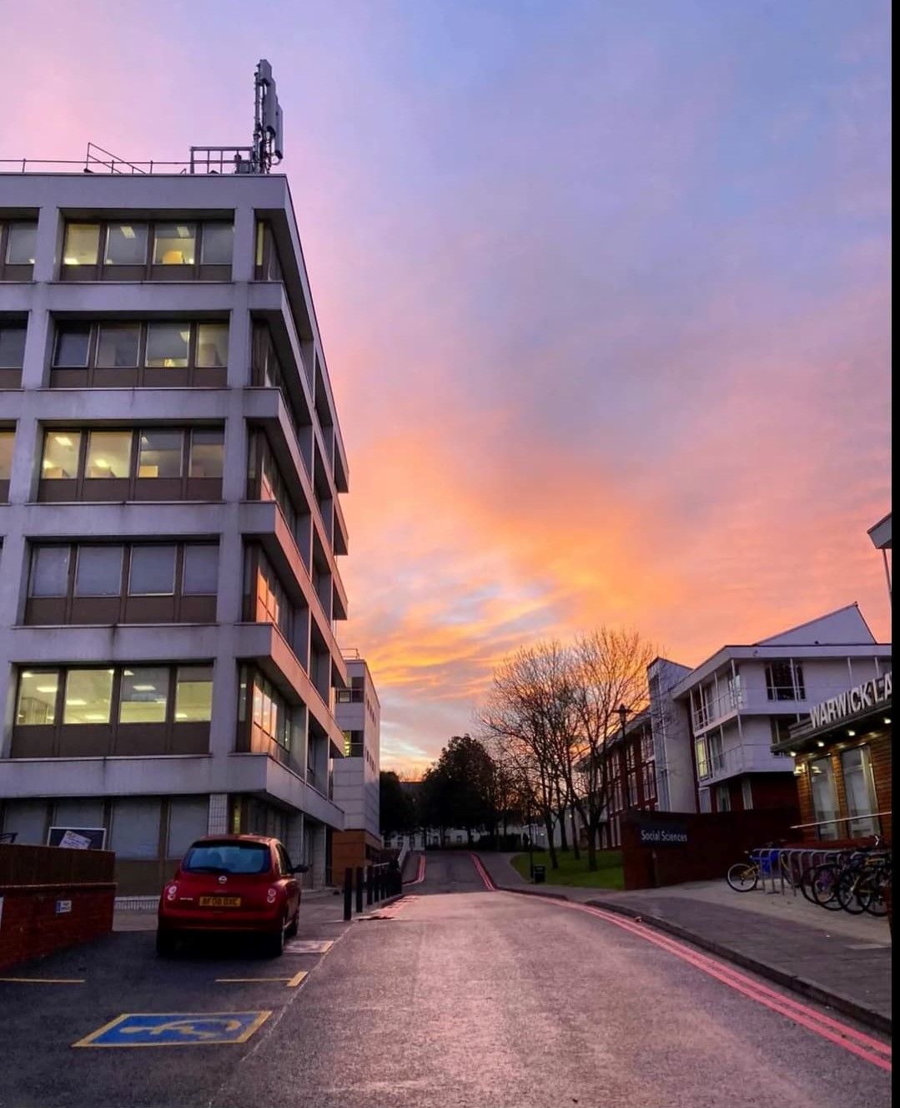
Origins
We all tend to think about our Library as a place to study, find books for our course and access academic support. However, it's more than just that. It's a place to socialise, escape the academic routine and relax in the diverse world of literature. If you are going home for the break, why not check out the Library for some summer reads? Discover our top leisure reads.

Slide 5
Origins
The Library is a place to:
Study
Find books for our course access academic support
Socialise
escape the academic routine
relax in the diverse world of literature
Check out the Library for some summer reads? Discover our top leisure reads.

Slide 6
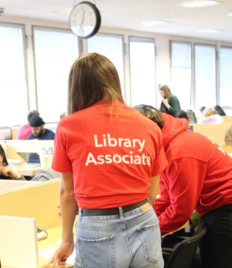
Origins
2017
Focus groups on Library Communications
2020
Students request a Library newsletter
2021
Renewed interest – leads to pilot "takeover" by students
Notes:
Warwick Library launched a new student-led Library newsletter in January 2022, but getting to that point took some time. The request for a student newsletter came from our Library Associates –our volunteer students who work in partnership with us, to gather student feedback and help the Library to respond to it.
Back in 2017 our Associates ran student focus groups on the topic of Library communications. This produced mixed comments about a library newsletter and many students felt it was a good idea but that students might not click on it.
In 2020, at the height of the pandemic, the Associates requested a newsletter and ran a survey to see if people would value a newsletter. They didn't get many responses – 26 responses in total – of these 13 said yes, 7 no, 6 maybe. We discussed the suggestion in the Library but plenty of people were unconvinced that it would be worth the effort.
The following year, in 2021 there was renewed student interest and the Associates expressed a very strong desire to be involved themselves in the newsletter. This time the Library committed to setting up a newsletter, but agreed that it should be student-led and co-created by Library staff and students to make it relevant for students and ensure the work didn't all fall on Library staff, with no audience! There was concern among colleagues in the University's central marketing team that students were overloaded with email newsletters, so it was agreed that the Library newsletter would be a twice termly "takeover" of the existing student newsletter, rather than setting up a new one – and this would also make the most of established channels and mailing lists.

Slide 7
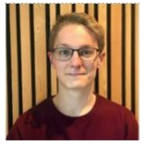
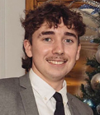
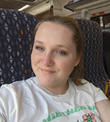
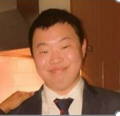
Recruitment
November 2021: opened recruitment
Content Creators: 14 applicants, 6 recruited
Editor: 8 applicants, 1 recruited
Notes:
In November 2021 we opened the call for recruitment to all undergraduates and Taught Masters students from all disciplines. Content Writer applicants had to demonstrate a good understanding of the Library, and how the Library can help with the issues faced by students and researchers. In total, there were 14 applicants, we initially intended for a team of three content writers, but due to the strength of the applications, we ended up recruiting six.
Recruitment for the editor additionally focused on commissioning and proof-reading duties. In total, we had eight applicants, appointing one – Harry – which meant we had a total team of 7.

Slide 8
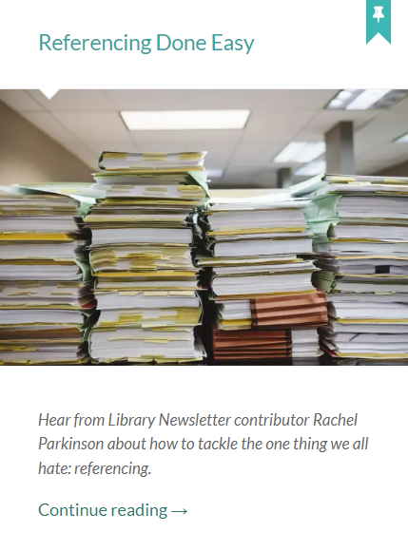
Practicalities
Frequency - two newsletters per term
Content - five/six articles per issue
Final approval by the Librarian
Notes:
As Kate introduced, the Library Newsletter is sent by the Student Comms team at Warwick, as ‘Takeover’ issues.
We send out two newsletters per term (weeks 3 and 8), including during term 3. The frequency between issues allows a practical gap for the team to develop and edit content.
As we have a larger-than-planned content writing team, we split them into two teams of three, with one issue allocated to each team per term.
There are 5/6 articles per issue, which typically translates into two pieces per writer, with an introduction and sign-off from the editor.
There are two types of article dependent on length – Long-form pieces are over 200 words and either published on the Study Blog, or the Library’s Newsfeed. Short-form pieces are either summaries of long-forms, or standalone articles.
Whilst the editorial team work alongside the editor to finalise the copy for each newsletter, the ‘final’ approval is provided by the Librarian.

Slide 9
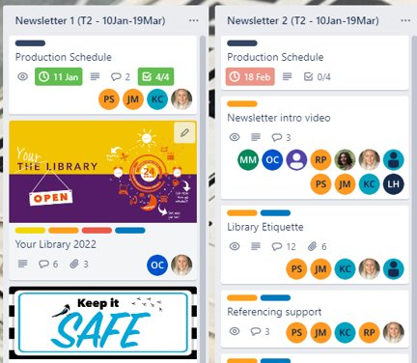
Issue Management
Trello
Long-form and short-form compilation
Communication preference
Notes:
Trello’s functionality and ease-of-access made it a good candidate for issue management. Experience of using Trello was also evident across the whole team, with applicants demonstrating familiarity with the tool in their interviews.
Trello allows us to divide the issues into lists, and assign writers to cards, where they upload their drafts. These are then compiled and worked on via a shared document. Once the final version of the newsletter has been approved, long-form and short-form articles are sent to either the Library Web or Study Blog Editor. Short-form pieces are sent to student comms.
Trello has also proven to also be the best tool for team communication, which we weren’t expecting. We set up an MS Teams space alongside Trello, and encouraged the team to use it for article discussion. However, the team have preferred to use Trello for all contact, with MS Teams falling a little by the wayside…we suspect Teams fatigue may be the cause, but nonetheless were surprised by its lack of take-up.
Now I’m going to audio-visually hand over to Sam, the Library’s Marketing & Communications Officer, who is going to talk about the reach and impact of the Newsletter.

Slide 10
Stats, impact, and most clicked content!
Notes:
Hi everyone. I’ll now share some statistics, to give you a feel for how our newsletter takeovers have performed, and what content has worked best.
So far we’ve produced 4 newsletter takeovers, and each was sent to approx. 28,000 students
Open rates varied between 29 and 44%, so on average 11,000 students read the newsletter each time! Our 1st ever takeover in week 2 of term 2 was opened by 8 thousand students, but this actually turned out to be our lowest open rate - our second takeover in week 9 of term 2 saw our open rate peak at 44%, equating to over 12 thousand students.
Click through rates have varied, but they generally align with those generated by the standard student newsletters produced by our main University comms team. This is really positive considering our takeovers are made up almost entirely of Library material, in comparison to the standard newsletters, which contain important uni updates such as exam information, or fun stuff like festivals and food fairs. In fact, our takeovers’ best click through performance at 11%, just topped the standard newsletters’ performance of 10%. This occurred in week 9 of term 2, and equated to over 3,200 clicks.
Our most popular links included:
The takeover introduction Video
Referencing blogs
The feedback forms
More books campaign
SCONUL libraries
Green library, and
Our Library associates blog post
We saw our lowest click rate in week 9 of term 3, although this was perhaps to be expected so close to the end of year. Still, we saw over 220 student clicks. Articles sparking the most interest at this time included:
Leisure Reading
PAT dogs, and
SCONUL access
4. Interestingly, our data shows that readers are accessing the newsletters via desktop rather than a mobile device, with a 55/45 split on average. We saw the number of desktop readers increase further to 69% in the latter half of term 2. At this time we also saw our highest click rate, so we think there’s a correlation here indicating that people are more likely to click through when working at a desktop.
So after all this reading and clicking, did we see any effect on Library services? Well, the answer is yes…
We saw a clear spike in readership on our Study Blog, with the blogs mentioned in the newsletter amongst the most visited. Content included:
Referencing Done Easy
Spotlight on the Library Associates
STEM students
Keep it safe
Top study tips
2. The newsletter intro videos that were hosted on YouTube received about 3 x more views than what we’d usually see for similar content.
3. We also saw a greater uptake to our Online courses. Comparing engagement from the week before and week after our newsletter issue, we saw an overall increase of 62% on the most used course activities, and significant increases in uptake of the specific courses mentioned, including:
Avoiding plagiarism, which more than doubled
Mindful library, which quadrupled
And Researching for Assignments, in which the first 2 sections of the course doubled, but the last 2 sections stayed the same. This is really useful information though, as we will now review the course and see if it needs to be reconfigured.
We’ve been happy with the stats so far, but what have our students had to say?
Generally, they seem to be impressed.
When asked how much they liked the newsletter, they gave us a 4.85 out of 5 star rating.
They’ve also shared lots of positive feedback with us. Their feedback also provided some helpful pointers, including flagging technical glitches, and making suggestions about items they’d like to see in the future!
I hope this whistle stop tour of our stats and content has been useful. Now back to my colleagues for even more info!

Slide 11
What We've Learned
Collaborating and co-creation
Building relationships
Proving support
Protecting the student voice
Notes:
Building relationships
The newsletter has been a collaborative effort that has meant building relationships across teams. First, we were lucky to have active and engaged group of students in the Library Associates, interested in getting involved with their library and which has been a key element in the newsletters success.
The newsletter project has extended this relationship further, with the student writers and editor working with Library staff as colleagues to produce the finished product.
For the writers and editor in particular this has also involved working with other teams across the University, such as the Central Communications Team with whom they might not have normally worked. This experience has provided valuable development opportunities beyond their studies.
Having these wider institutional connections has also had the value of the newsletter's distribution being embedded within the wider university communication strategy, rather than becoming just another email from the library.
Supporting and Librarian role
The newsletter was pitched as a library student takeover, and a key aim was that it should come from the students with the student voice. So what role for Librarians?
On the whole the role of the Librarian Team was simply to create a framework in which students could work freely and independently.
However, we found that our student writers were initially adapting their voice to write for the library, instead of writing from their perspective. Indeed, the University Librarian, who gave great support to the project, commented on drafts of the first issue, that it didn’t sound student enough.
It took active encouragement, along with a conscious change in mindset across the team to find the confidence to write in a different way, and which developed through subsequent issues.
We also had an editor who was very committed to this ethos, and supported the writers to make this change, which consequently resulted in greater student ownership of the writing and production.
There was always an internal content review built in as part of the process, but the quality and engagement shown by our writing and editorial team meant that this was always light touch and never resulted in content being rejected, blocked or changed, thus protecting the student voice.
Now you're going to hear from our Editor, Harry Sun, for the student perspective on the newsletter.

Slide 12
From the Editor...

Slide 13
The Future
Continuing progress
Building engagement
Increasing student involvement in Library communications
Notes:
Future Plans
The newsletter has enabled us to really engage our wider student body with their library, particularly through a period during which access to the physical library continued to be restricted.
Most importantly, the newsletter has given us a new platform that placed the student voice front and centre within our Library communications, and with a reach that has surprisingly out-performed social media channels.
The impacts that we have seen from the number of times the newsletter was read, along with click throughs to blogs and other sites, has demonstrated both the value and power of the student voice in Library communications. It has shown that it can make a significant difference in reaching students, even when using a more traditional emailed format.
As a result of all these positive factors driven by the newsletter’s success, we are currently planning recruitment for new writers and editor for 2023 to continue the newsletter and maintain the student voice within the Library and beyond.
We hope that this has provided some inspiration for engaging students in your Libraries. That perhaps if social media isn’t getting the attention or engagement you’d like, how rethinking an approach with strong student involvement and talking to their peers, it can increase engagement in a very positive way for all involved and provide a bit more ownership of what is after all, their library.

Slide 14
Tell us how we did
We hope you’ve enjoyed the presentation.
Tweet @WarwickLibrary to tell us what you think, or email us academicsupport@warwick.ac.uk with any questions you might still have!

Slide 15
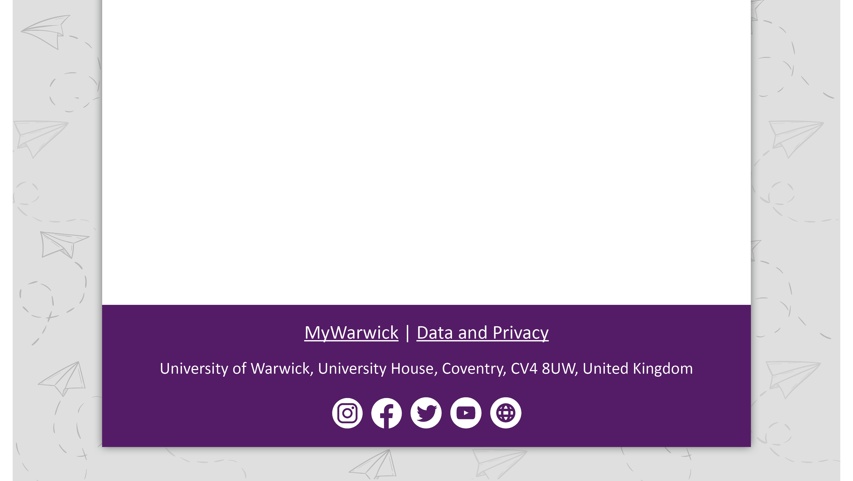
Thanks for listening!
We hope you’ve enjoyed the presentation. Thanks from us, your presenters, and our student content team:
The Library Newsletters were delivered by our student content team including: Harry Sun (Student Editor), Liam Velani, Luke Holloway, Matt Munnelly, Daira Povez Gamboa, Olivia Collins, Rachel Parkinson.

