Slide 1
Steady as she goes: establishing the SafePod service at University of Nottingham
Jane Grogan, Senior Research Librarian
6th September 2022

Slide 2
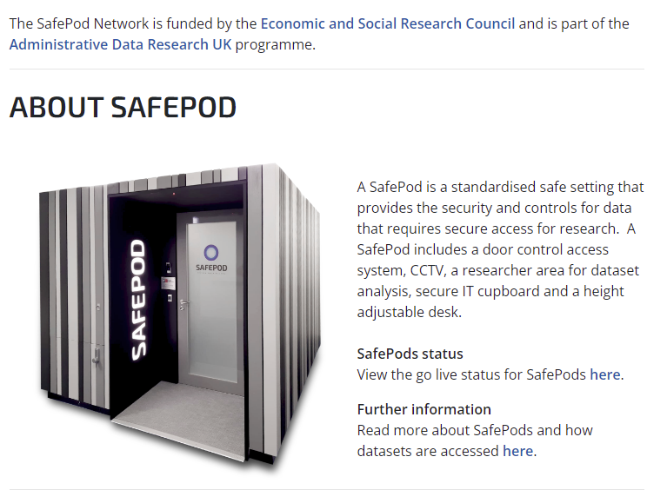
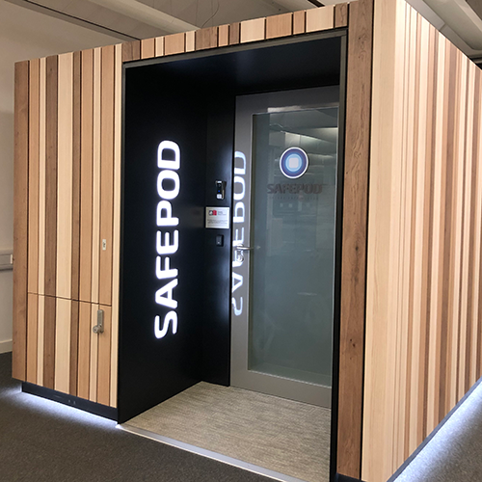
What is a SafePod?

Slide 3
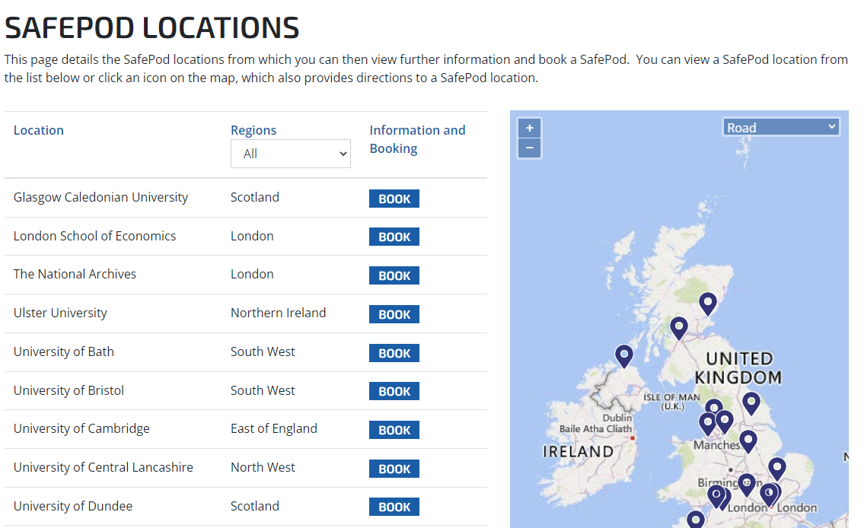
The SafePod Network
Notes:
We bid to be part of the SafePod Network in 2019

Slide 4
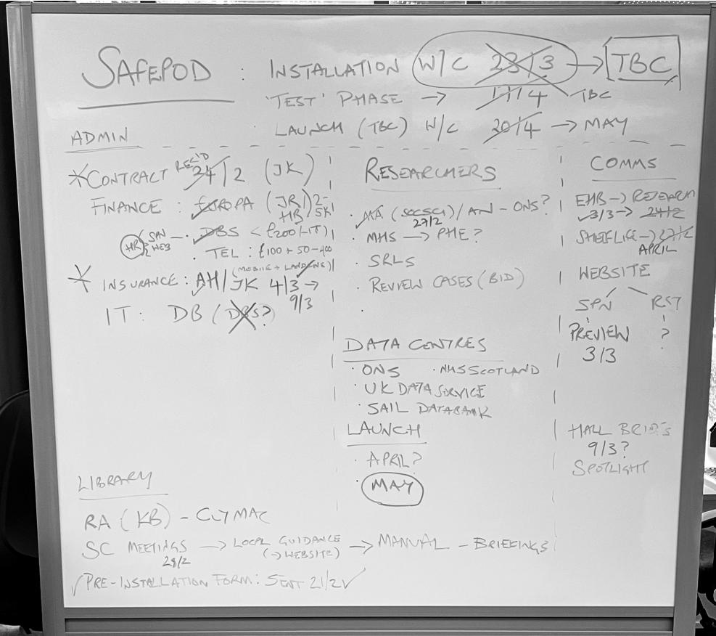
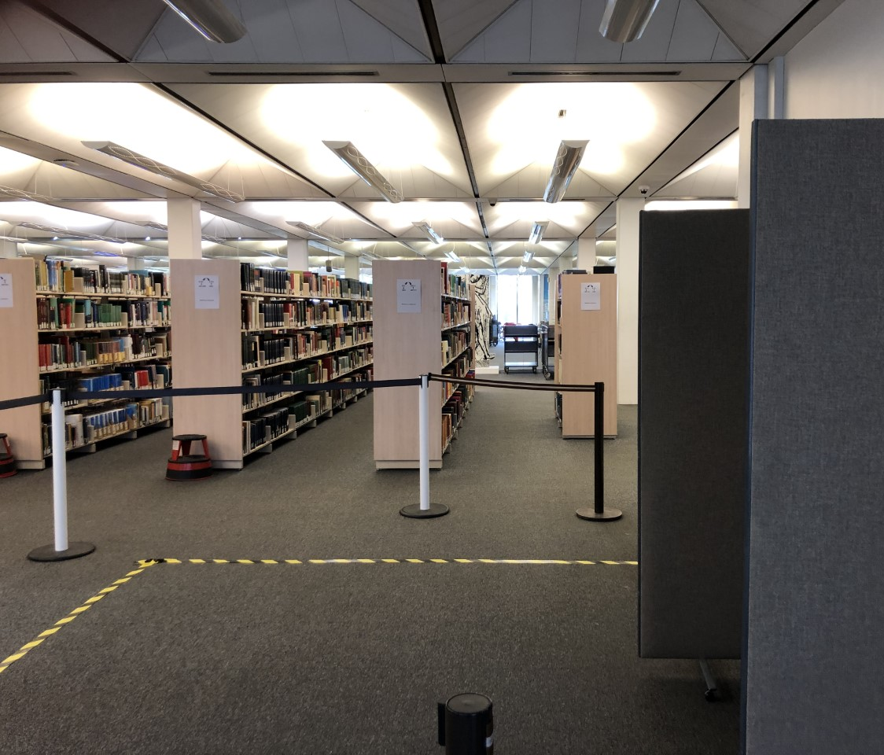
Installation planning! Partnering across departments
Notes:
Once we learned we were succesful in our bid to host a SafePod we were able to get started on planning for installation. Hand in hand with SPN and their installation team, Paneltech. We expected at one stage to be the first institution to install a SafePod with our installation date planned to be March 23rd 2020. However, lockdown was announced and the date had to be pulled. We finally relieved to get our SafePod in November 2020 (fifth I believe). I wanted to show a snapshot of our mission board for those who are looking towards their own installations as it was a complex effort to join up Estates, IT, Network security, electrical contractors, HR and Libraries to make it happen! Comms across the network. Darren's role. Talking to Lancs and Leics ahead of installation.
Once happily installed, we then had to wait a further 9 months – mainly due to Covid delays - before the launch of the network in August 2021 – we were one of a handful of SafePods available for booking from launch.

Slide 5
Role of UoN Libraries: partnering across teams
Institutional host ​
The SafePod is located in Hallward Library​
SafePod Coordinators​
Four library staff, working across teams (three from Customer Services and one from Research Support)​
What do Safepod Coordinators do?​
Induction, security checks before and after use, fault reporting, troubleshooting, cleaning, enquiries​
Developing service​
Oversight from 'Senior responsible person'; advocacy, promotion, liaison with network
Notes:
Touch on how we deliver the service day-to-day. Cost of staffing borne by Library. Important role of security-cleared Coordinators. Collaborative working across teams, CS provide more Coordinators, RST are contact point for enquiries, update webpage, liaise internally with academic contacts (researchers, RA, R&I, senior academics).

Slide 6
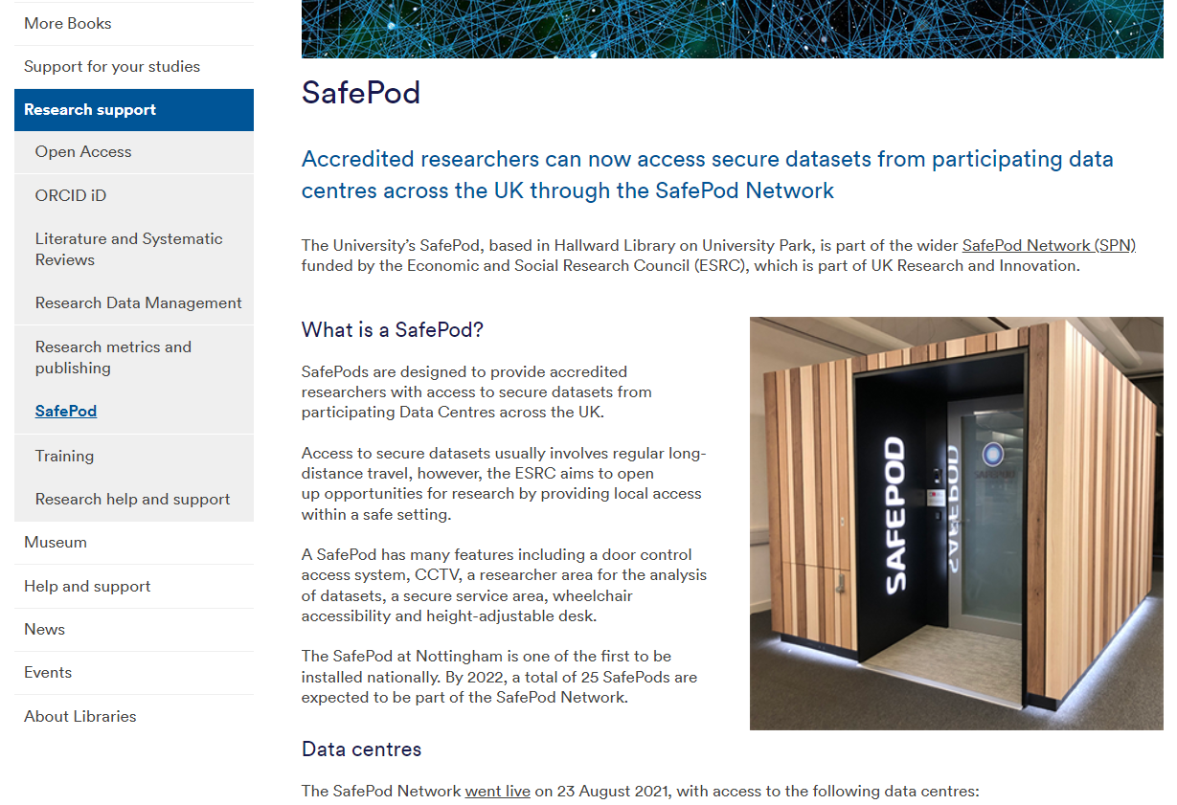
Promoting the SafePod
Notes:
Internal promotion: referenced already (e.g. webpage; Research Exchange blog to get the word out, PVC Research; Library spotlight session. Advocacy to library staff); external promotion: UKSG editorial; Mercian newsletter and conf.
https://www.uksg.org/newsletter/uksg-enews-509/safepod-network-six-months-launch

Slide 7
SafePod data centres and users
Current data centres
UK Data Service (UKDS)
Which researchers?
'Accredited' researchers
Scottish Government
Any discipline
Any institution
SAIL Databank (Welsh)
Office for National Statistics (ONS) Secure Research Service
Social Sciences (ESRC)
Notes:
Accredited researchers – those with a live project with an SPN data centre

Slide 8
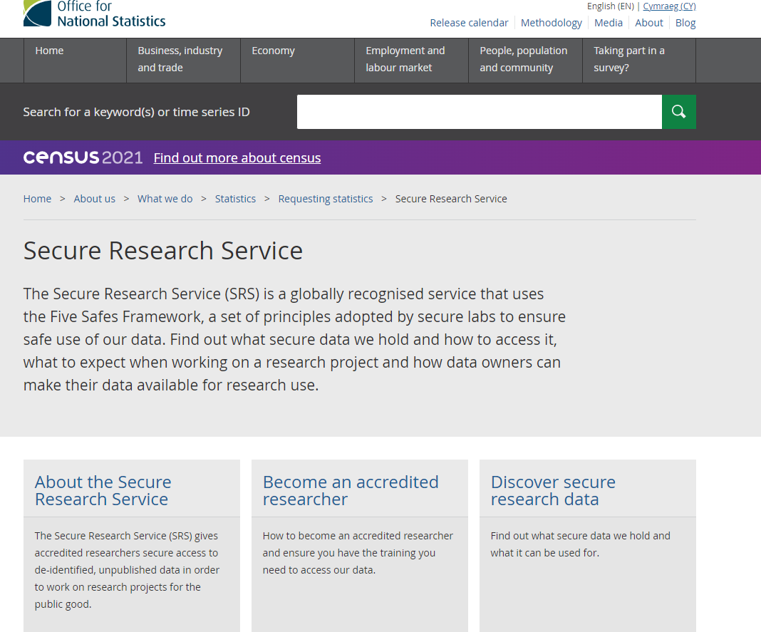
Partnership with researchers: Mike Adkins, Post-doctoral research fellow, School of Education

Slide 9
Future development: just getting started!
University of Nottingham SafePod: https://www.nottingham.ac.uk/library/research/safepod.aspx
Queries direct to Jane Grogan or library-researchsupport@nottingham.ac.uk

