Slide 1
Textbook Project
A review of students' use of textbooks pre and post Covid-19 pandemic
Nicola Dennis and Kerstin Treder
Information Specialists
Aston University Library

Slide 2
In this presentation:
Project overview
Project results by activity:
Online survey
Focus groups
Academic interviews
Usability testing
Project limitations
What we have learned and recommendations for the future

Slide 3
The project
Timescale: 6 months, December 2021 – June 2022
The project team (Information Specialists)
Aim: to investigate students’ study habits and how they may have changed throughout the pandemic. To have an insight on: students’ use of print and e-books, their preferences for e-book platforms, usability features and how they access content for study.
The activities:
Online survey
Focus groups
Usability testing (students)
Academic interviews

Slide 4
Information Specialists
Clare Langman
Information Services Lead
Nicola Dennis
Aston Business School
Aston Law School
Richard Hopkins
Social Sciences & Humanities
Kerstin Treder
Engineering & Physical Sciences
Sarah Akhtaruzzaman
Assistant Information Specialist
Giada Zanella
Health and Life Sciences

Slide 5
The online survey

Slide 6
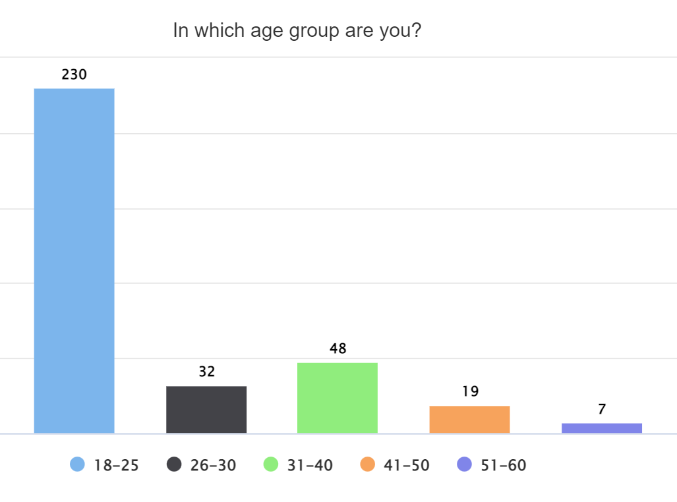
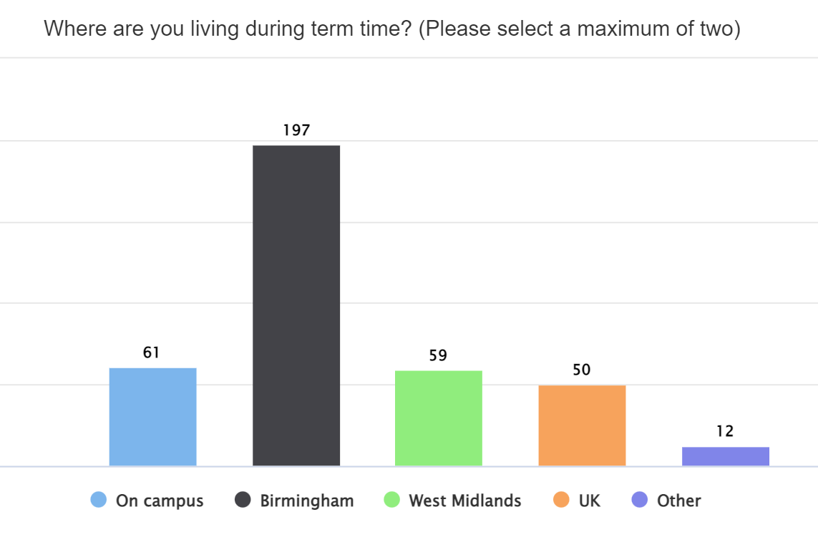
Participants overview: demographics
336 participants
Majority 18-25, in Birmingham

Slide 7
Participants overview: programmes
Majority undergraduates, full-time (93.7%)
Undergraduates | 181
Postgraduates | 147
Foundation | 4
Doctorate | 1
Health and Life Sciences | 114
Eng and Physical Sciences | 45
Business and Social Science | 160
(of which Social Science and Humanities) | 14
Joint HLS/BSS | 6
Joint EPS/BSS | 6
Joint HLS/EPS | 3

Slide 8
Survey main findings
E-books and print books are equally popular re preference, but actual usage is higher on e-books
Distance and age were the most significant variables which predicted behaviour, with students who were younger and/or living further away from campus being more likely to use e-books
Students are less likely to use annotations and highlights within e-books
Students who cannot access print books are more likely to notify the library, but they are more likely to contact their lecturer if they can't access e-books
Engineering and Physical Sciences students more likely to answer in favour of print books (preference and usage)
The older the student, and the further they live, the more likely they are to buy their own copy

Slide 9
Other UX activities

Slide 10
Focus groups – main findings
In line with online survey results but provided greater insight.
E-books: used more often and accessed via:
reading lists (Talis) and links from lecture slides
SmartSearch (discovery tool) less often, in context of further research or projects
Differences across Colleges, programmes and modules in the way reading lists are set up. For example: UG Business vs. Design Engineering vs. Sociology
PGs more confident in navigating reading lists and SmartSearch and make full use of e-book tools.
UGs: used video content (f.e. YouTube), have a need for clearer instructions and use PDFs of textbooks from external sources. They feel less confident with problem-solving.

Slide 11
Usability testing – main findings
Confidence in accessing e-books via different routes is largely dependent on how their course and reading list is set up (example: Medicine student)
Quite confident in navigating the e-book itself to find specific information
Lack of awareness of how SmartSearch works and how to solve an issue (logging in, different links available etc.).

Slide 12
Academic interviews – main findings
Lecturers make use of both print and e-books, however, for practical reasons, core texts are required in electronic format, especially when the cohorts are large. This format will therefore be prioritised in the reading lists across programmes.
Print books are still encouraged to be used for specific purposes in some programmes (reading novels for English, applying formulas etc.)
Expectation of online resources which are easy to integrate in teaching and learning, ranging from e-textbooks to multimedia
Lecturers confirmed that, in some occasions, students would buy their own copies of textbooks, sometimes because of lecturers’ own suggestions
Very different uses of reading lists. For some, these include clear instructions for students and are embedded in content delivery. For others, lists present recommended and further reading that students are expected to explore independently. In some cases, reading lists are not used at all.

Slide 13
Conclusions

Slide 14
Limitations
Students' uneven representation
Lack of print and e-book granular data
Selection bias of academics
Limited College-level analysis

Slide 15
What we have learned and recommendations
Students
Purchasing own copies
Academics
Use of reading lists
Multimedia: copyright considerations
Resources
Providing resources beyond e-books
Maintaining strong e-book provision
External resources: critical evaluation skills and copyright issues

Slide 16
Thank you!
Any questions?

