Slide 1
Realigning the Doctoral Training Programme at Loughborough University: Determining learning preferences.
University Library

Slide 2
Overview
Share findings from our survey/focus groups, conducted with researchers to understand their experiences of training.
Reflections on the implications and our responses to the findings.
Thoughts on feedback mechanisms.
Group discussions.

Slide 3
Who are we and who do we work with
Library
Doctoral college
Emphasis on face to face with a gradual shift to online

Slide 4
User perspective
What does our research community really want?
Have we been making assumptions?
How did we ask them?

Slide 5
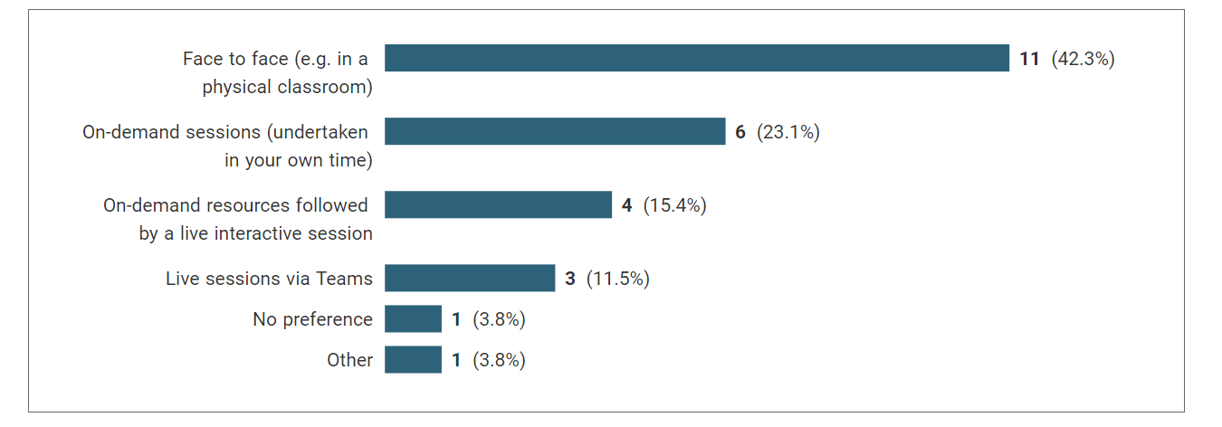
Findings
Q 10. If you were given the option, which method would you prefer to use to access learning/support materials?
Q 10. If you were given the option, which method would you prefer to use to access learning/support materials?

Slide 6
Findings
Q11: What sorts of materials would you prefer to have access to?

Slide 7
Findings
On line training is very useful for part time students with full time jobs
Some of the courses really need physical interaction, some may not, depends on the workshops
Remote sessions are good - you can do them whenever, play/pause and take time to make notes
Flexibility is good
If the trainings are only on-demand videos, we can already find most of the content online

Slide 8
Findings
Also, being in the room with other researchers. Collective learning. Even virtual live via Teams is not the same. [F2F is] more productive, seeing other people around researching
Personally, online is not the best option…the online experience is not the same as the physical experience…Not my learning preference
In class learning is more productive. Easier for the presenter to support the learning, Sees it. Immediate interaction
I miss the face-to-face training

Slide 9
Conclusions from findings
Pragmatic response to learning
See value in both in-person and online teaching
Seek networking opportunities through learning

Slide 10
How did we respond?

Slide 11
How do we measure … ?

Slide 12
Discussion
How is your offering to researchers delivered?
Why do it that way? How did you come to that decision?
Do you collect feedback?
What is this feedback measuring?
Have you considered any other ways of taking feedback?
Notes:
10 minutes
Consider how training and workshops are delivered in your instiyution.
Think about how you choose to deliver it that way. For example, was it evidence based or was it a more practical decision?
Do you collect feed from your training? Realistically what is this measuring?
Have you considered a gaining a broader user perspective of your users experiences? How might you go about that?
We don't expect you to cover all of this in 10 minutes – just focus on the part that interests your group or that you feel is the most pertinent at the current time.

Slide 13
Feedback

Slide 15
Any questions?

Slide 16
Contact us:
j.de-lillo@lboro.ac.uk
n.p.rush@lboro.ac.uk
Inspiring Winners Since 1909

