Slide 1
Empowering researchers: Using personalised action plans to develop researcher engagement with metrics, PIDs and profiles
James Barnett and Vicky Wallace
Research Skills Advisors, University of Birmingham
j.w.barnett@bham.ac.uk, @jameswbarnett, https://orcid.org/0000-0001-5284-4246
v.j.wallace@bham.ac.uk, https://orcid.org/0000-0003-3640-2223

Slide 2
Introduction
Research Skills Team:
Skills support for PGR to Professor
Established 2017
Metrics:
Citation metrics
University rankings
Responsible metrics
Evolution of metrics offer:
Introductory workshop
Raising your research profile

Slide 3
But then success!
‘Influential Researcher’ programme from Library Services Research Skills Team
853 researchers reached during 2020 and 2021, benefitting from bespoke action plan and contextual presentation.
How did we achieve this?
What are the benefits?
What are the next steps?

Slide 4
Almost a wicked problem
What do researchers need to know?
CRIS
Publication profiles
ORCID
Responsible metrics
Why?:
Reputation
Author disambiguation
Efficiency
When?

Slide 5
Our approach
How?
40 minute presentation
Personalised action plan
Opportunity for follow up
Who?
Library Research Skills Team
External relations
Where?
Initially face-to-face
Online via Zoom

Slide 6
Current offering
Influential Researcher intranet pages
Influential Researcher online course
Online,
45 minute workshop –
open
or bespoke
Personalised mini action plan
121 support

Slide 8
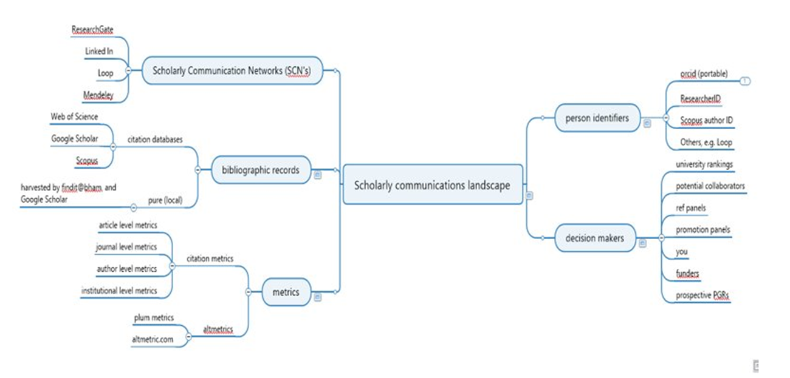
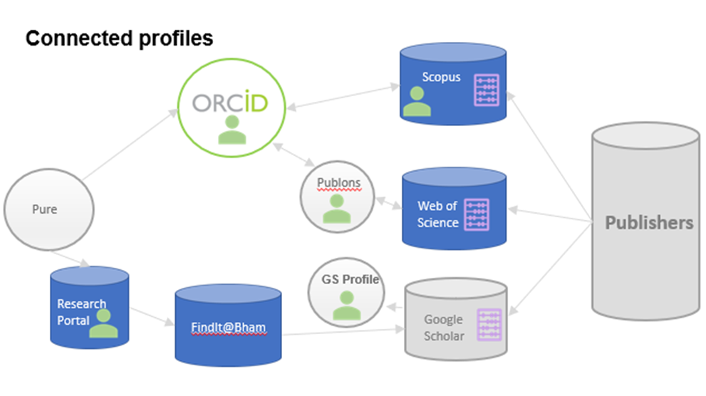

Slide 9
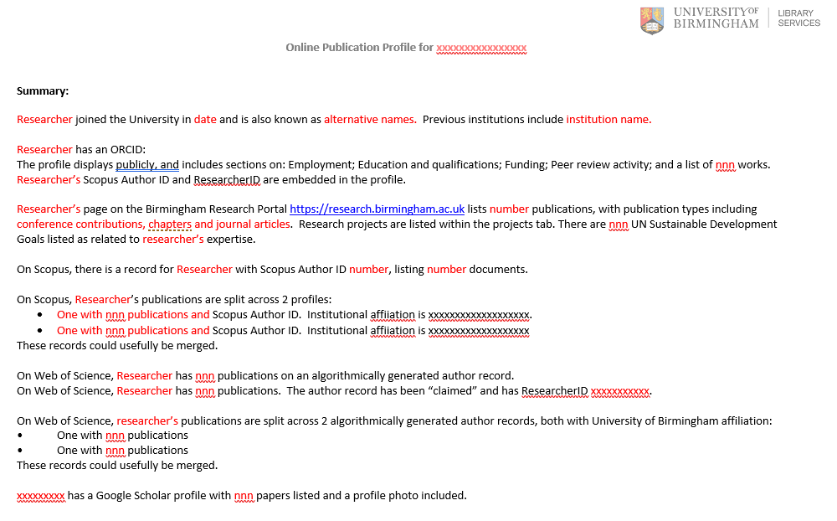
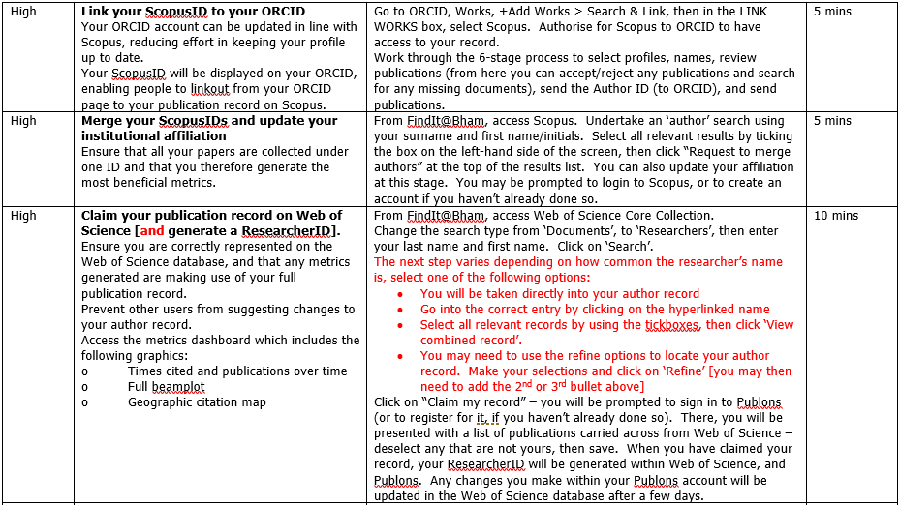
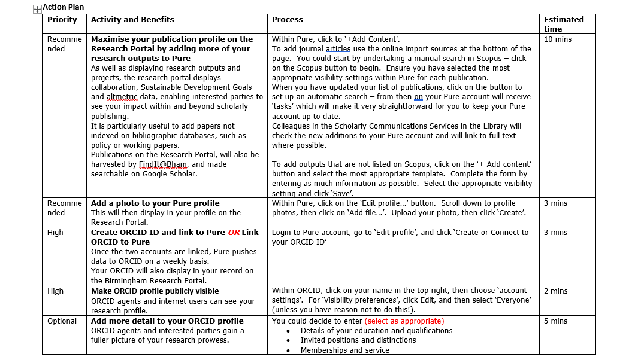

Slide 10
The Action Plan
30-60 mins to prepare
“Reverse appointments”
10-40 mins to complete
Non-judgemental
Voluntary
Spreadsheet of evidence

Slide 11
Demo
Notes:
Approx 15 minutes

Slide 12
A selection of (anonymous) feedback
The most useful library thing I’ve ever done.
The Canvas Module is really good… it really is a module that everyone in the University should be aware of
[T]he school leads said how brilliant the workshop was and two people said it changed their life!!
This is so helpful. Thank you once again! I really appreciate that you took the time to help me 😊
It was pitched exactly right and I know several staff are already inspired to improve their metrics
This document [the action plan] is so, so helpful.

Slide 13
Benefit | For the Library | For the Researcher | For the University
Initiative a “golden thread” to Birmingham 2030 strategic framework and university’s aspiration of breaking into the top 50 of the world’s leading universities.​ | ✓ |  | ✓
Library has increased reputation as a trusted partner within researcher community, opening avenues for conversations around Open Research and Responsible Metrics. | ✓ | ✓
Researchers more engaged with Open Research and Responsible Metrics concepts, increasing institutional readiness for culture change in these areas. |  |  | ✓
Learning more about (and addressing) problems with algorithmically generated author profiles on citation databases. | ✓ | ✓ | ✓
Increased awareness of persistent identifiers (PIDs) such as ORCiD, publication profiles, and the current state of play with research metrics. |  | ✓
Learning more about disciplinary differences, e.g. Physics (pre-print culture to factor in), Medicine and Business (multi-affiliation). | ✓
Successful partnership working with External Relations. | ✓ |  | ✓

Slide 14
Next Steps
Measure longitudinal impact of Action Plans
Completion rates
Qualitative conversations with researchers
Continue to (re)engage researchers on metrics
Target new starters?
Refresher workshops?
Mandate attendance?

Slide 15
Thank you for listening!
Any Questions?

