Slide 1


Playing FAIR
Karen Goodson and Michelle Mayer
Queen’s Award for Enterprise
International Trade 2022
Shortlisted for University of the Year
The Times and Sunday Times Good University Guide 2021
Top 100 in the World for ‘International Outlook’
THE World University Rankings 2022
Joint Top Modern University for Career Prospects
Guardian University Guide 2021 and 2022

Slide 2
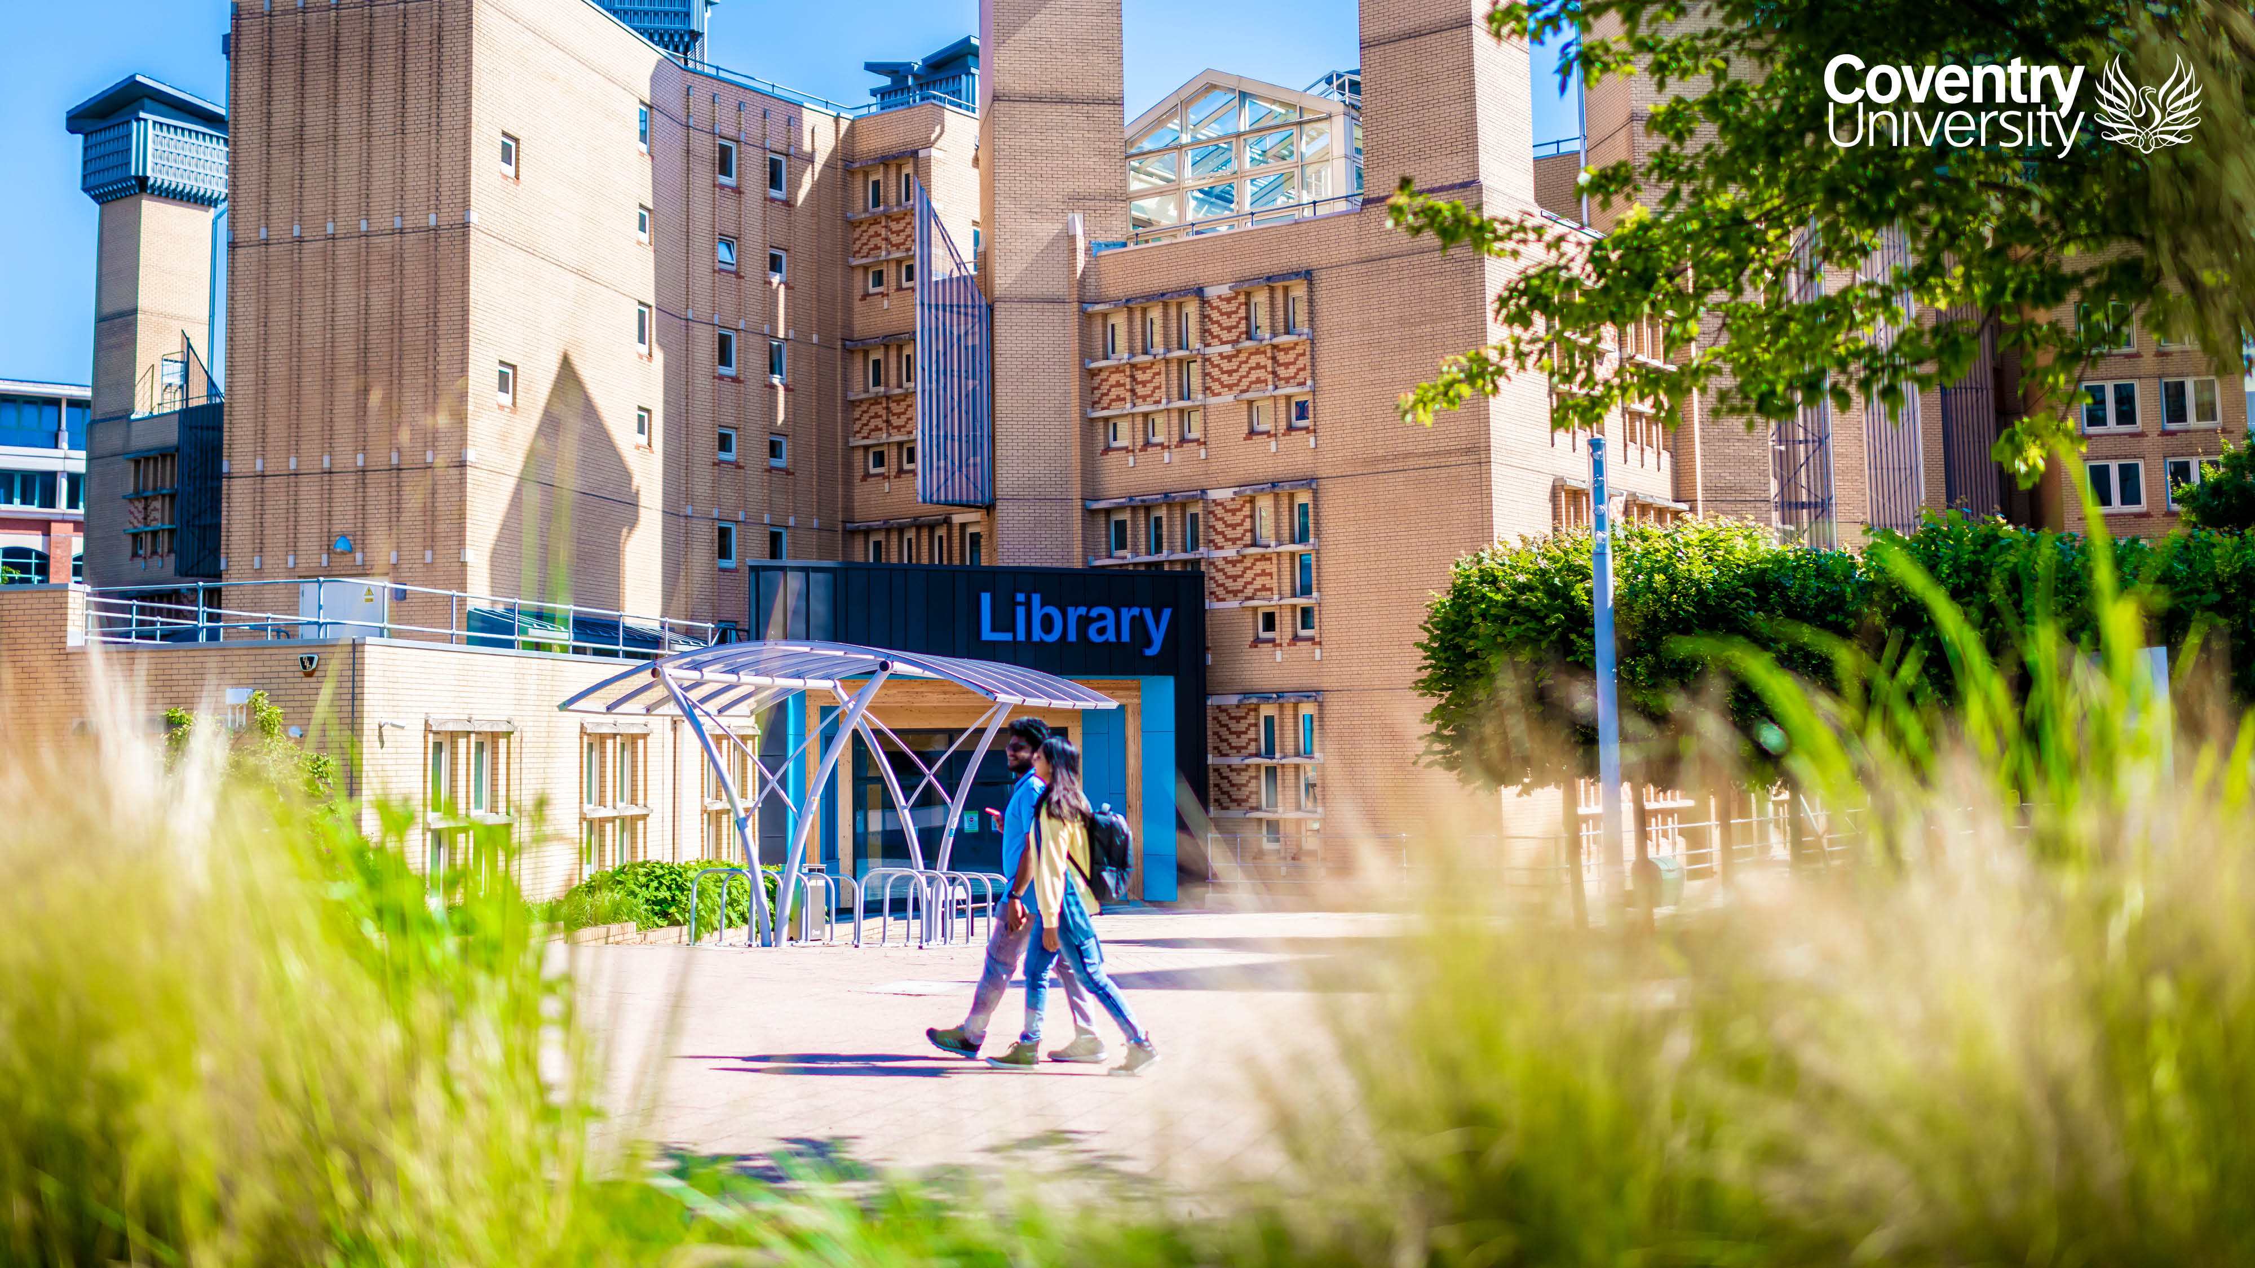
Karen and Michelle
Notes:
Michelle is Research Data Management Officer at Coventry University. She joined the now Research and Scholarly Publications Team, following undergraduate and postgraduate studies at the university. She has been part of the team for eight years, providing support for RDM, Open Journal Systems, and occasionally reviewing CU Professional Services ethics applications.
Karen joined Coventry University 21 years ago, starting in IRS as a Library assistant. Four years ago, she joined the Research and Scholarly Publications Team as a Senior Information Assistant, where she provides support for PURE, the Library repository, and Open Access. She is now enjoying learning more about RDM.

Slide 3
Background
that led to the creation of our activity
Reflecting on Open Access Week activities
Browsed the internet for RDM gamified sessions
Decided to create a game to teach a feature of RDM
Potential to create inter-Research Centre competition between PGRs / ECRs?
Notes:
Following the release of several games promoting Open Access, the Research and Scholarly Publications Team explored gamification methods, with the aim of making the dissemination of open data information entertaining. We produced a story to introduce research staff and students to the FAIR Principles, incorporating where they could also find guidance for RDM support in the Library.
The game details expanded on:
why researchers should follow the FAIR Principles for data sharing,
where guidance for RDM can be found at the university,
introducing the institutional repository to share research data and related information.
Our presentation would like to share the process in the creation of our game, how it was received by colleagues and students, our thoughts on the activity and what we would like to do next. We hope this will lead to further ideas from the audience to improve our game/create new offerings.

Slide 4
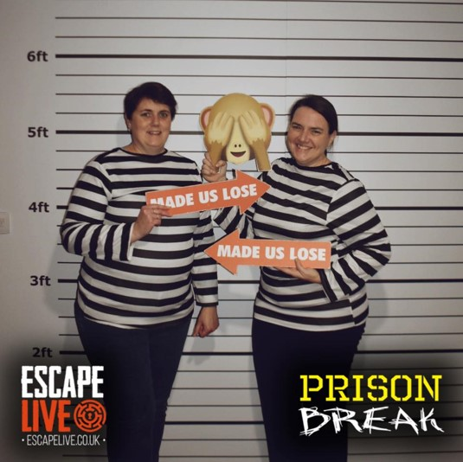
We attempted an escape room
All in the name of research
Notes:
Popped to a local escape room to research what was involved, as we’d never attempted one before.
Gave an idea of what a typical room was like: the puzzles, time limit, teamwork.
We enjoyed the activity.
Decided to go ahead with creating a story.

Slide 5
Creating our activity
The story?
What did we want to achieve?
What items and training were available from other Library / Disruptive Media Learning Lab escape room style activities?
What did we need to create / purchase for our puzzles?

Slide 6
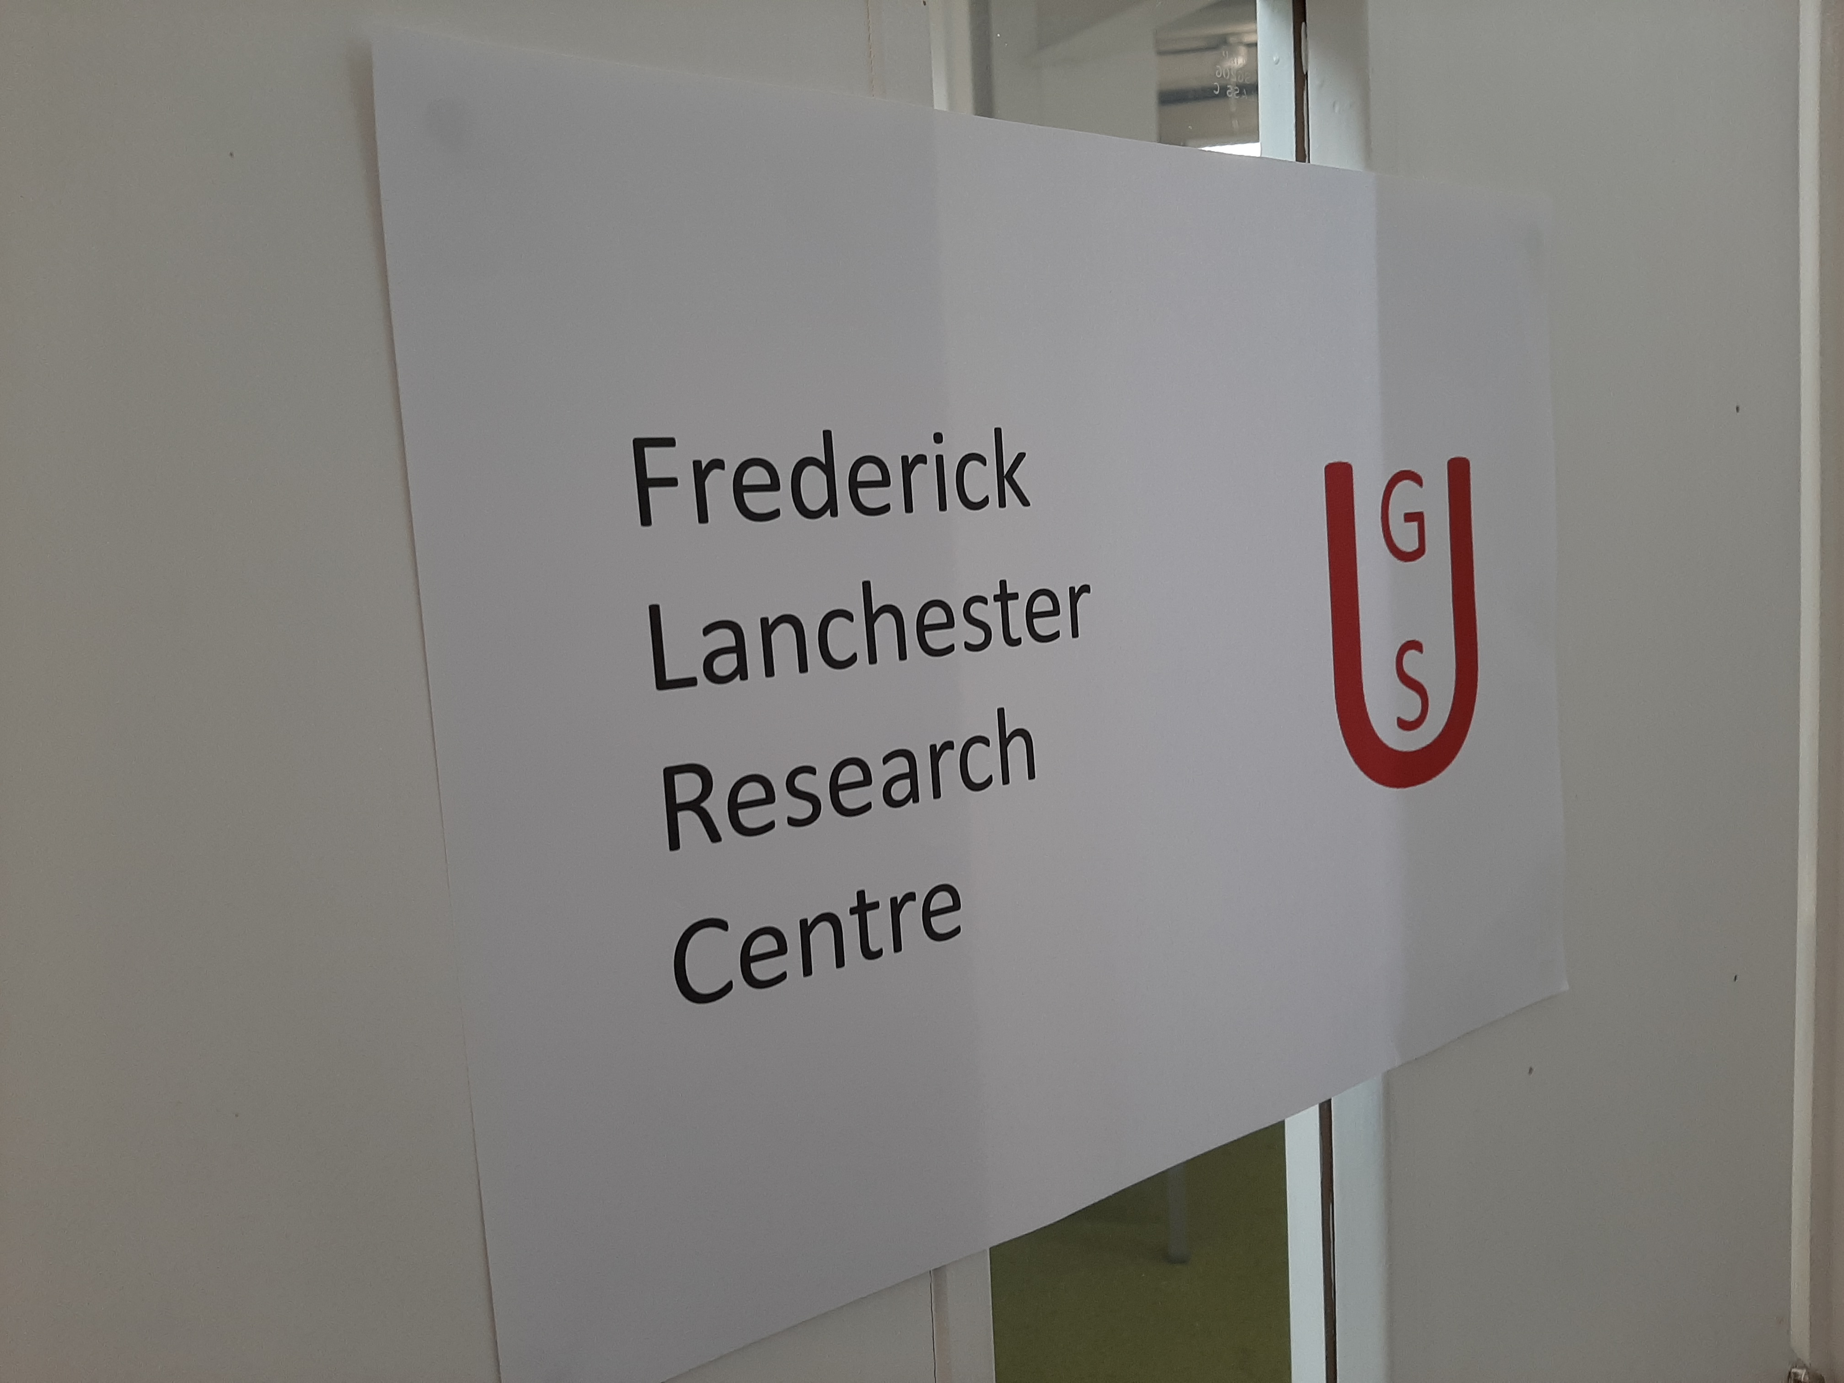
The story?
The story
Recovering lost (science) data? A zombie or antidote scenario? FAIR Principles

Slide 7
What did we want to achieve?
Aims
The importance of Research Data Management and fulfilling Funder requirements. Provide information on The FAIR Principles. RDM guidance at Coventry University: LibGuides, Locate the library catalogue, Location of RDM Officer and Research and Scholarly Publications Team. Opportunity to upload documents to the test platform of the institutional repository – something participants may be required to do on the live platform at a later date.

Slide 8
Items, guidance, training?
Items
Rummage through the suitcase containing puzzles and escape room items.
Guidance, training
Chats with academic liaison librarian colleagues who had run escape room activities as part of the library inductions. Guidance from Disruptive Media Learning Lab (DMLL) colleagues who specialise in gamifying teaching resources. Attended an escape room teaching session from DMLL.

Slide 9
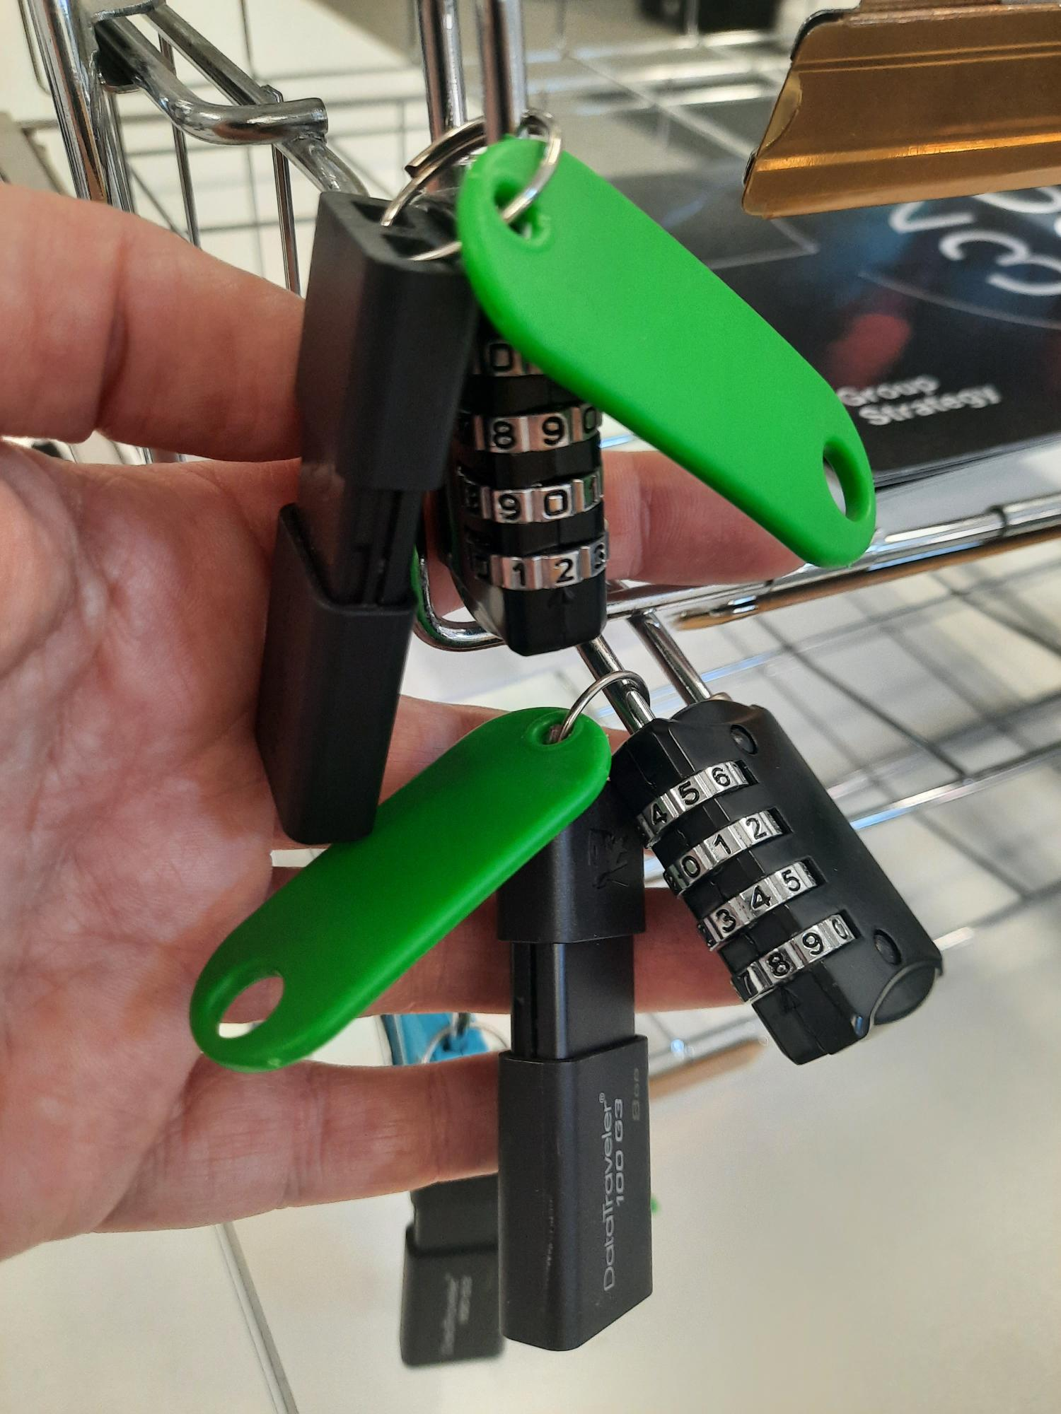
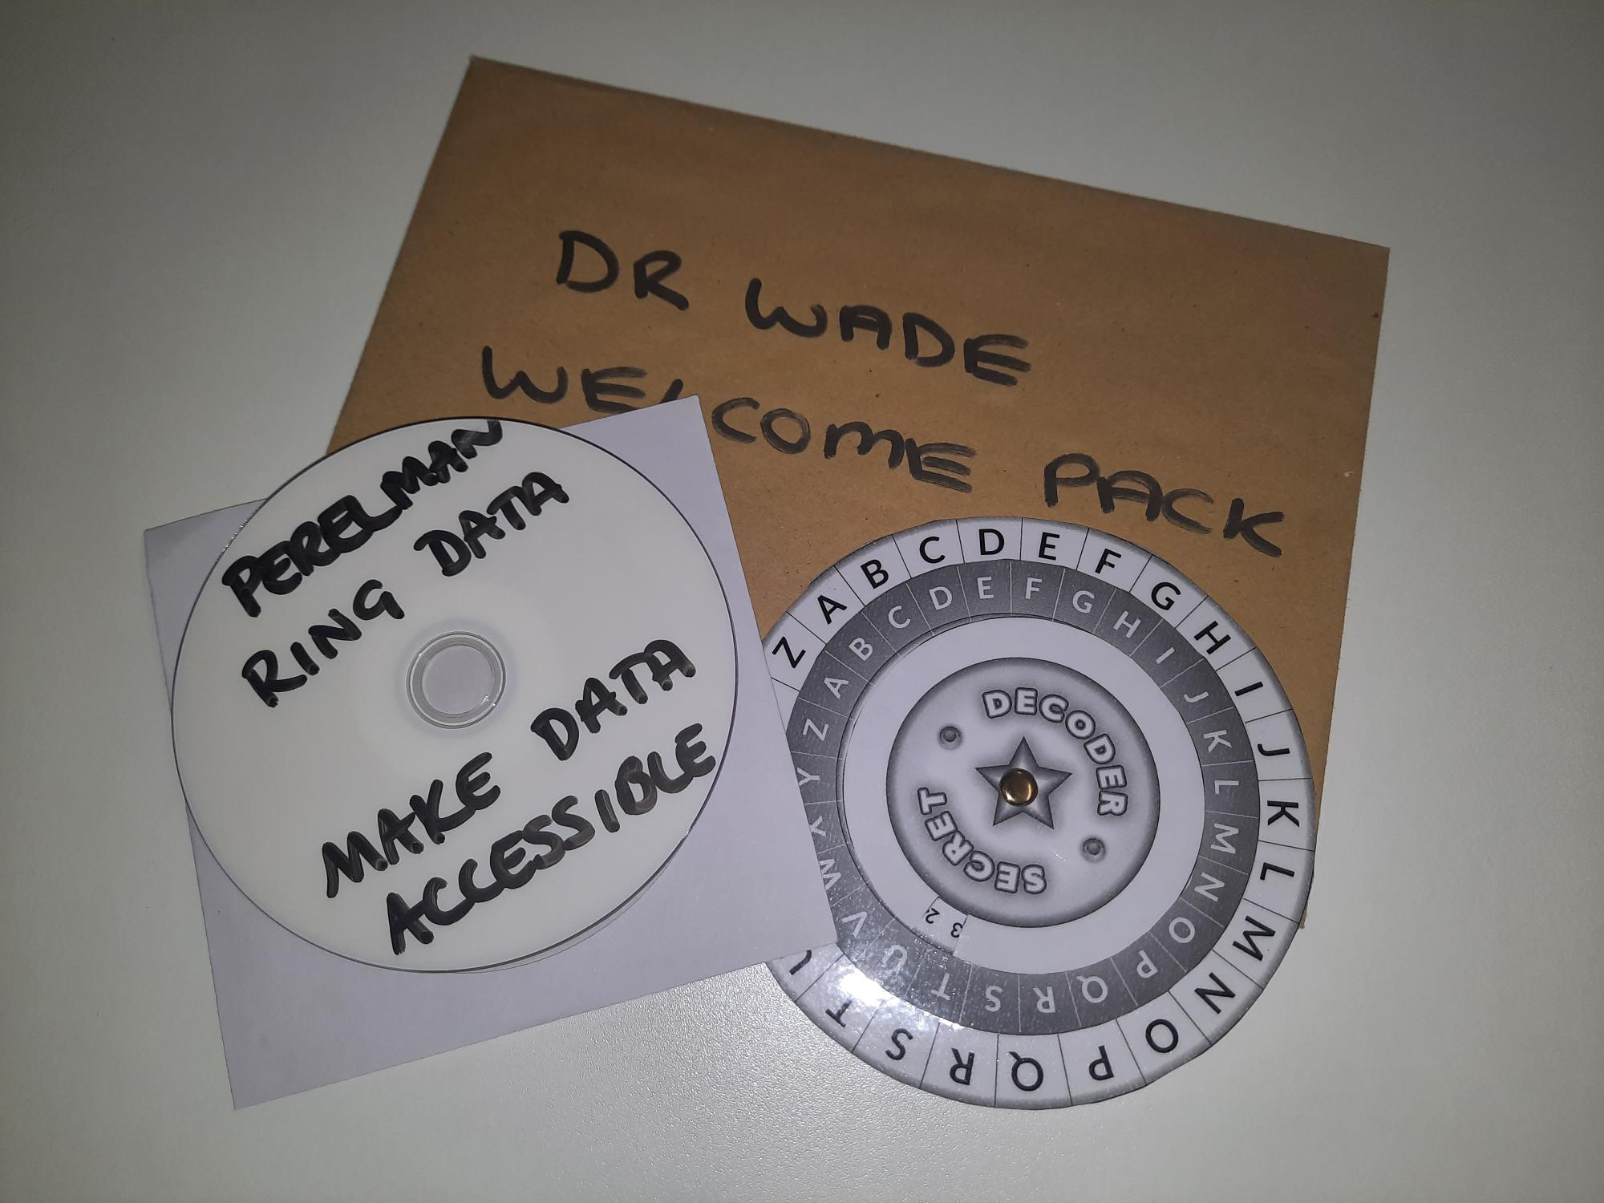
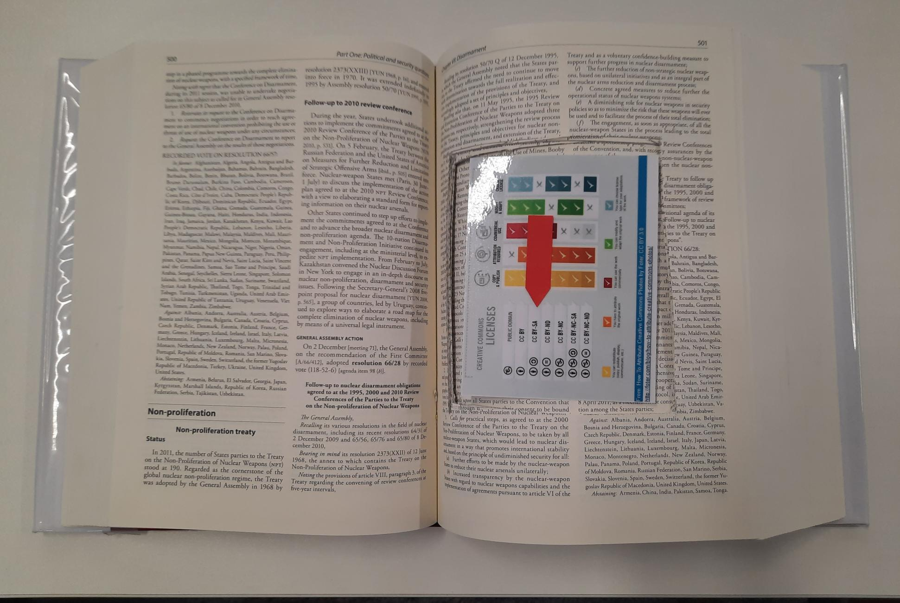
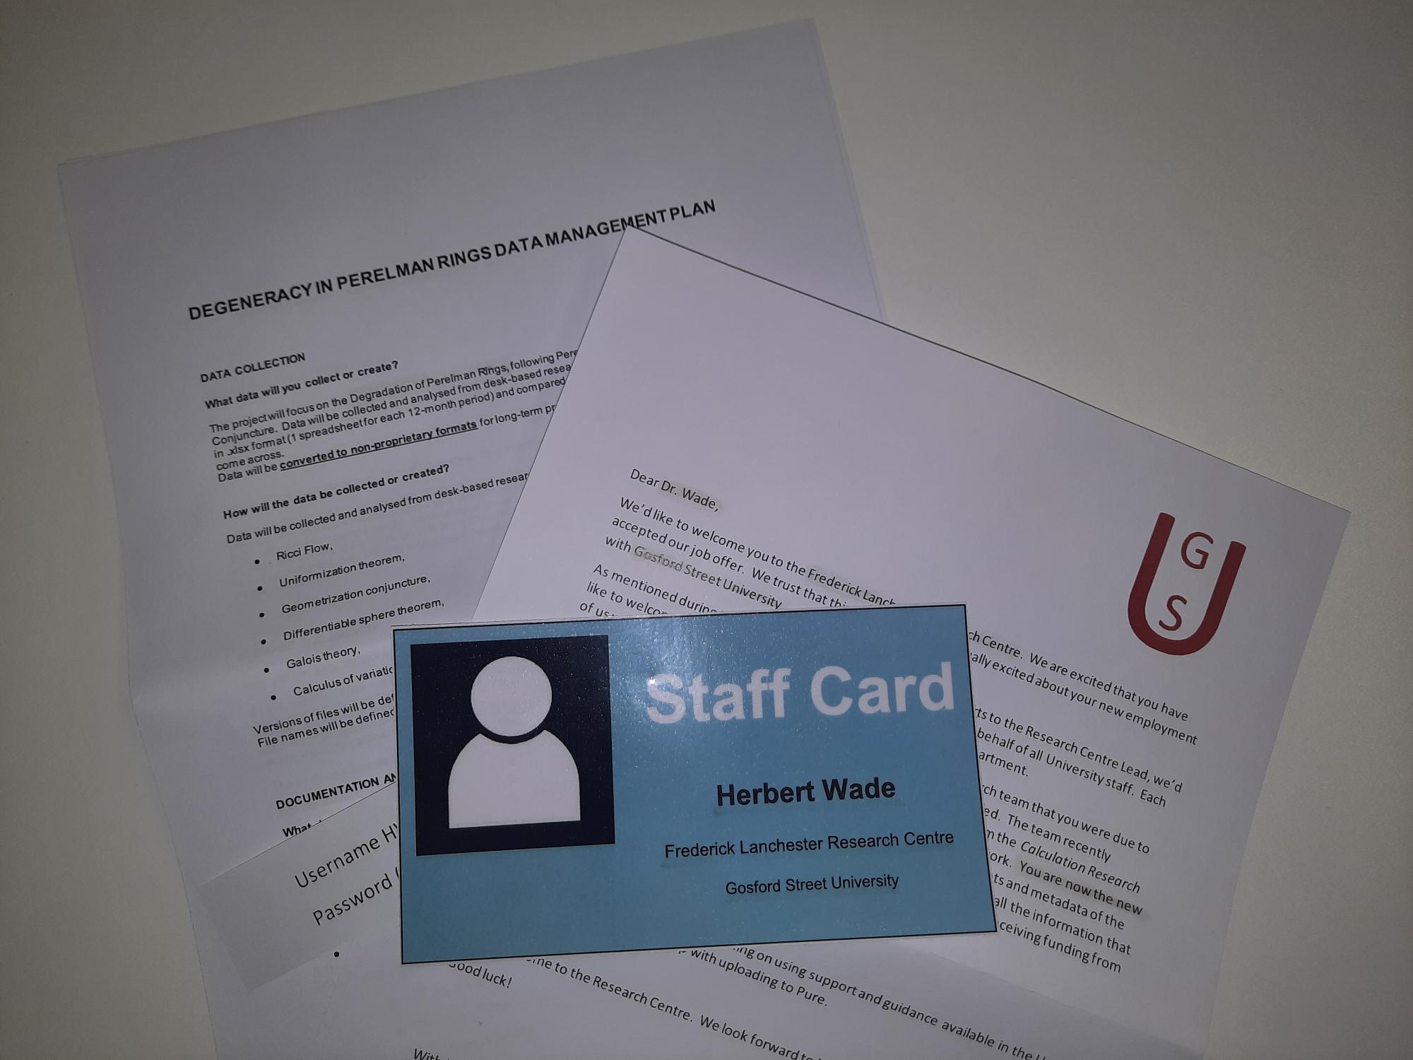
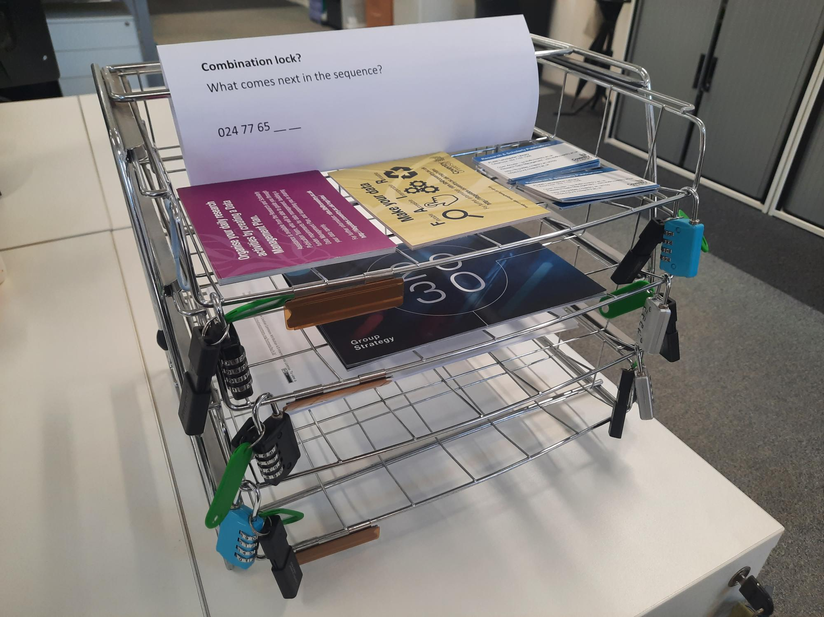
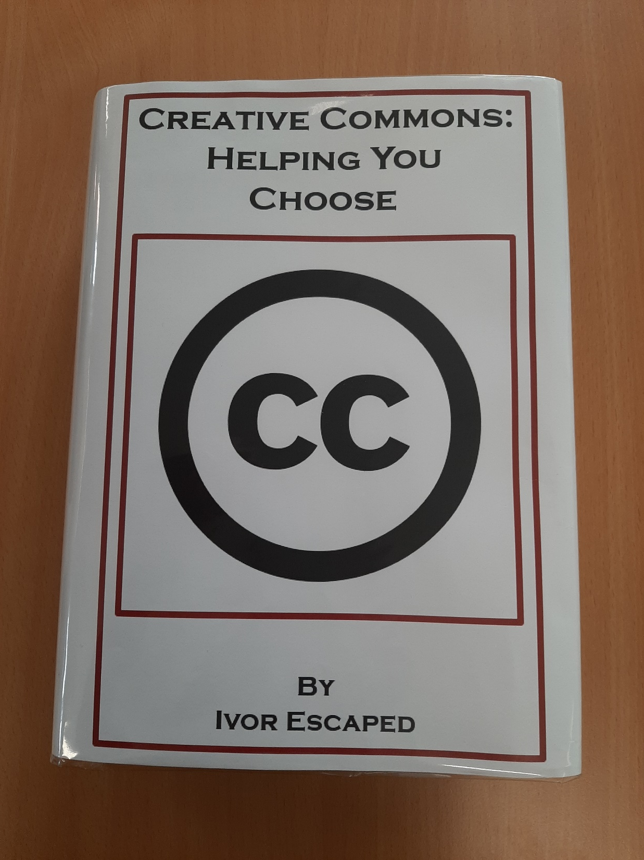
What did we create?
Notes:
Riddles / Clues
CC Book – to find the CC license that the data needed to be shared under.
Creative Commons help others to see...
Potential uses. In a book, Dewey starting 303.
So Locate me and then, hey diddle diddle,
You’ll find your answer; take a look in the middle.
Directing participants to FL320 – to transfer data from CD Rom to memory stick
Code and decoder.
Combination lock? To release the memory stick from the document holder
What comes next in the sequence?
024 77 65 __ __
75
68
Metadata record info – Symbols in the room to create the sentence below? Had to show us the answer so we released the UV torches to find the highlighted metadata in the documentation.
Record your Metadata! Highlighting important information to share so others can reuse your data.
Clue to use of LibGuides to find out how to upload data and metadata to Pure
Have included link at the bottom of the ‘New Job’ letter.

Slide 10
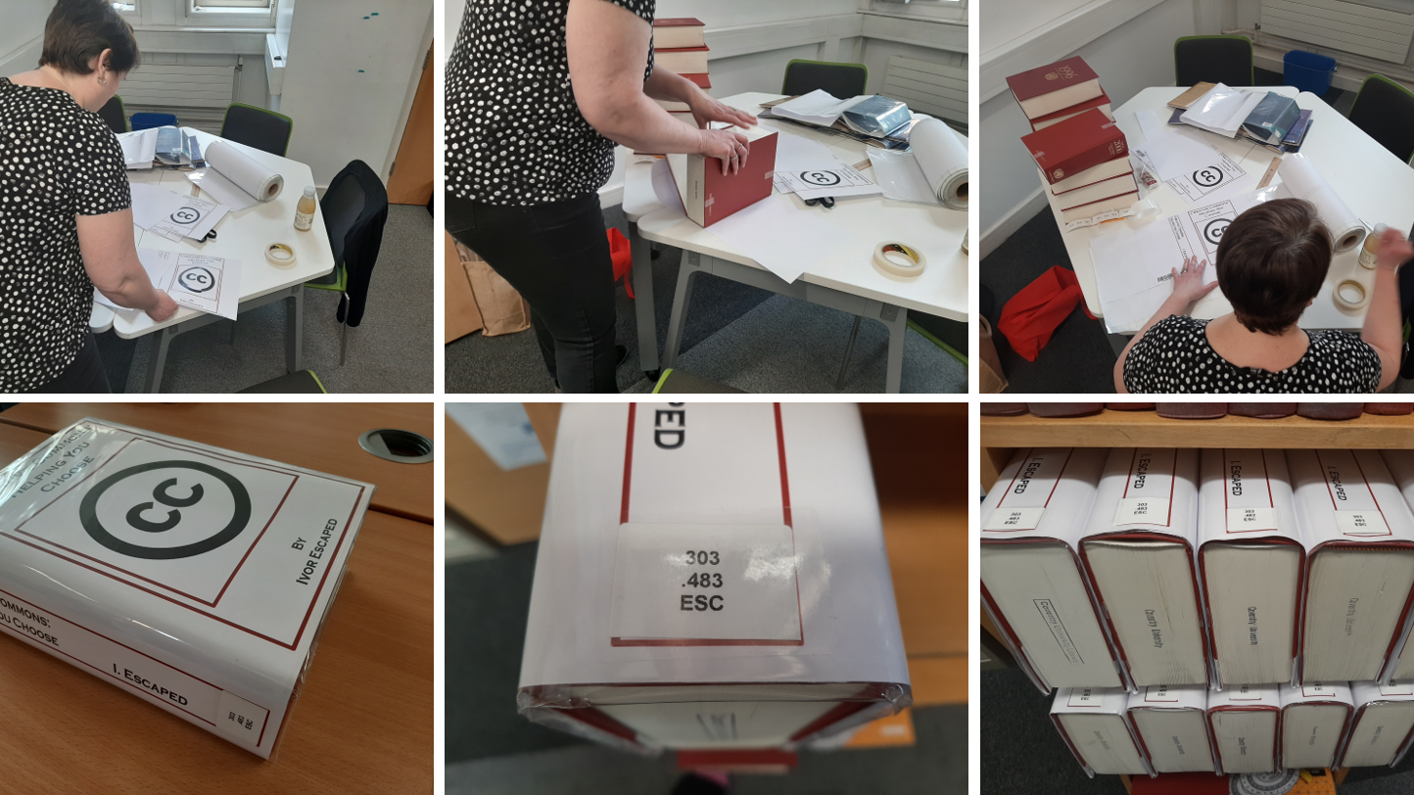
What did we create?

Slide 11
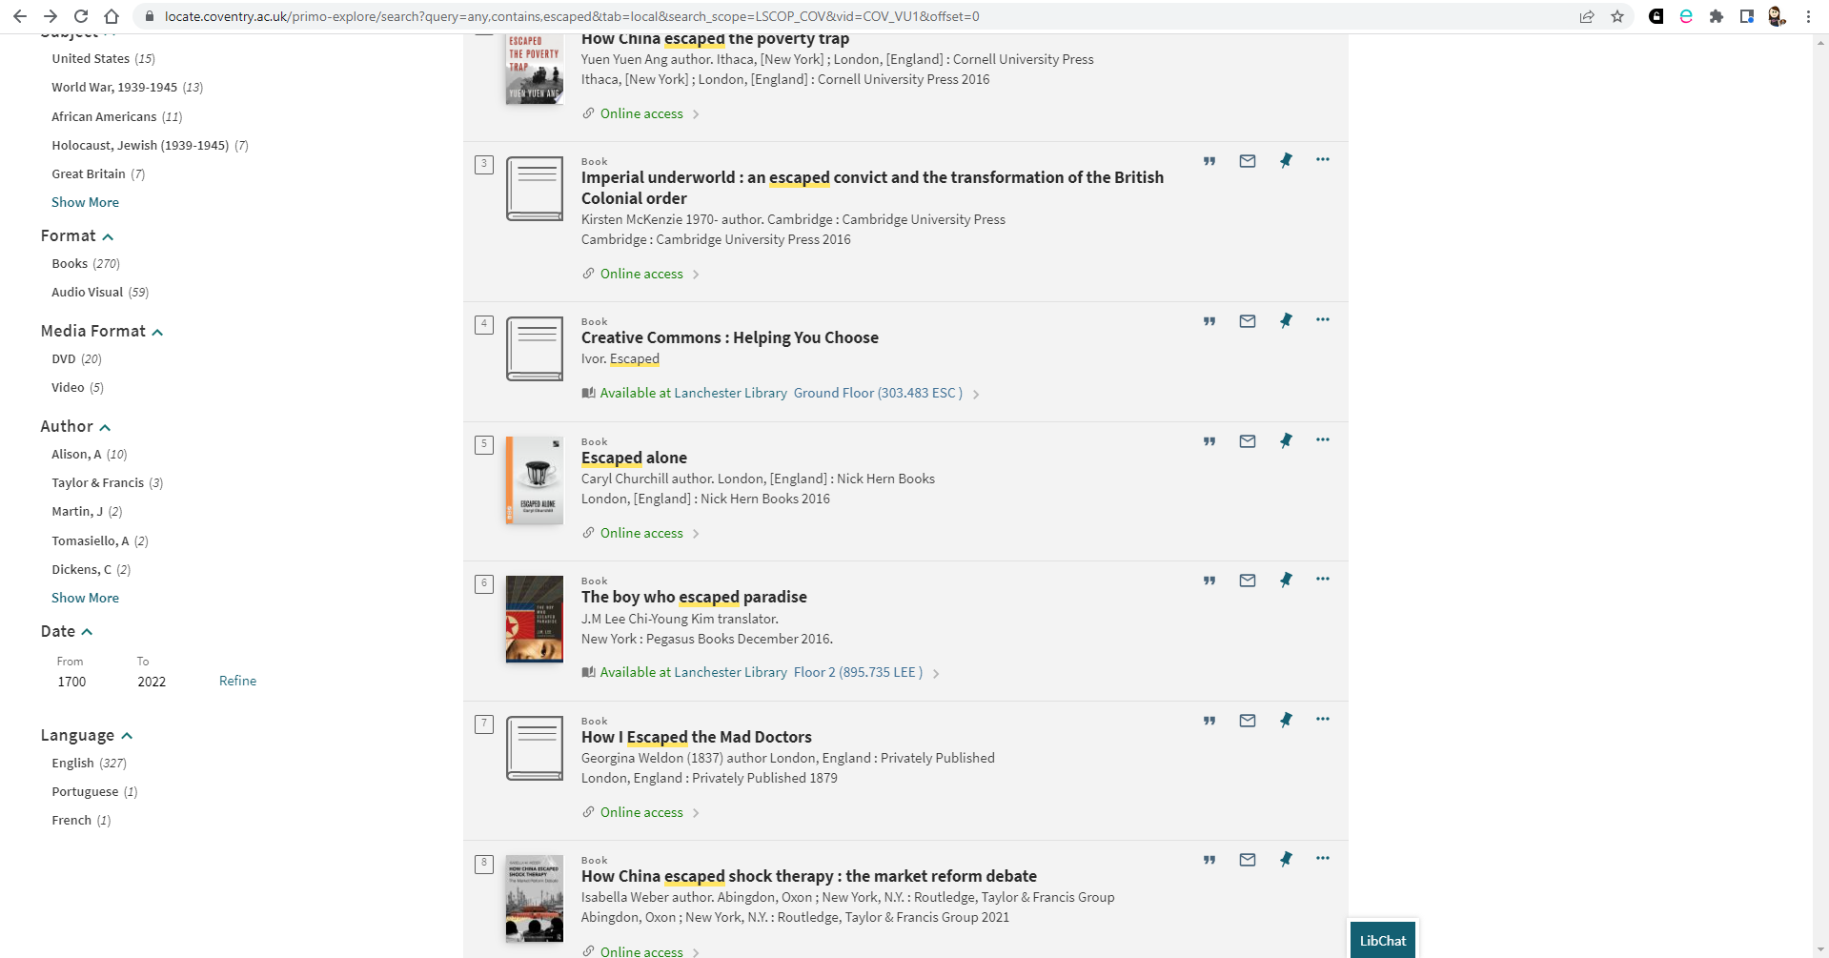
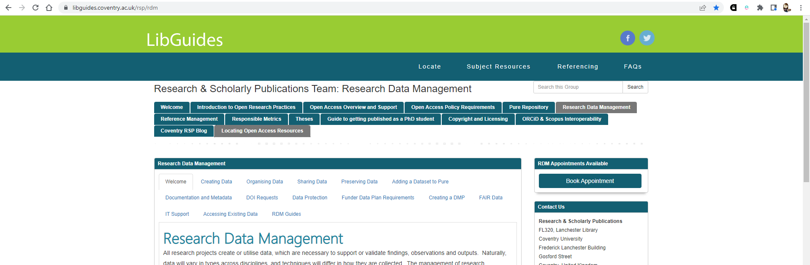
What did we create?

Slide 12
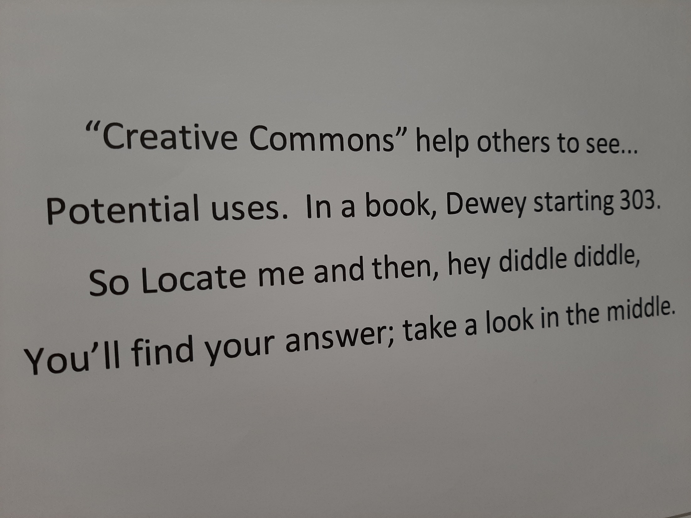
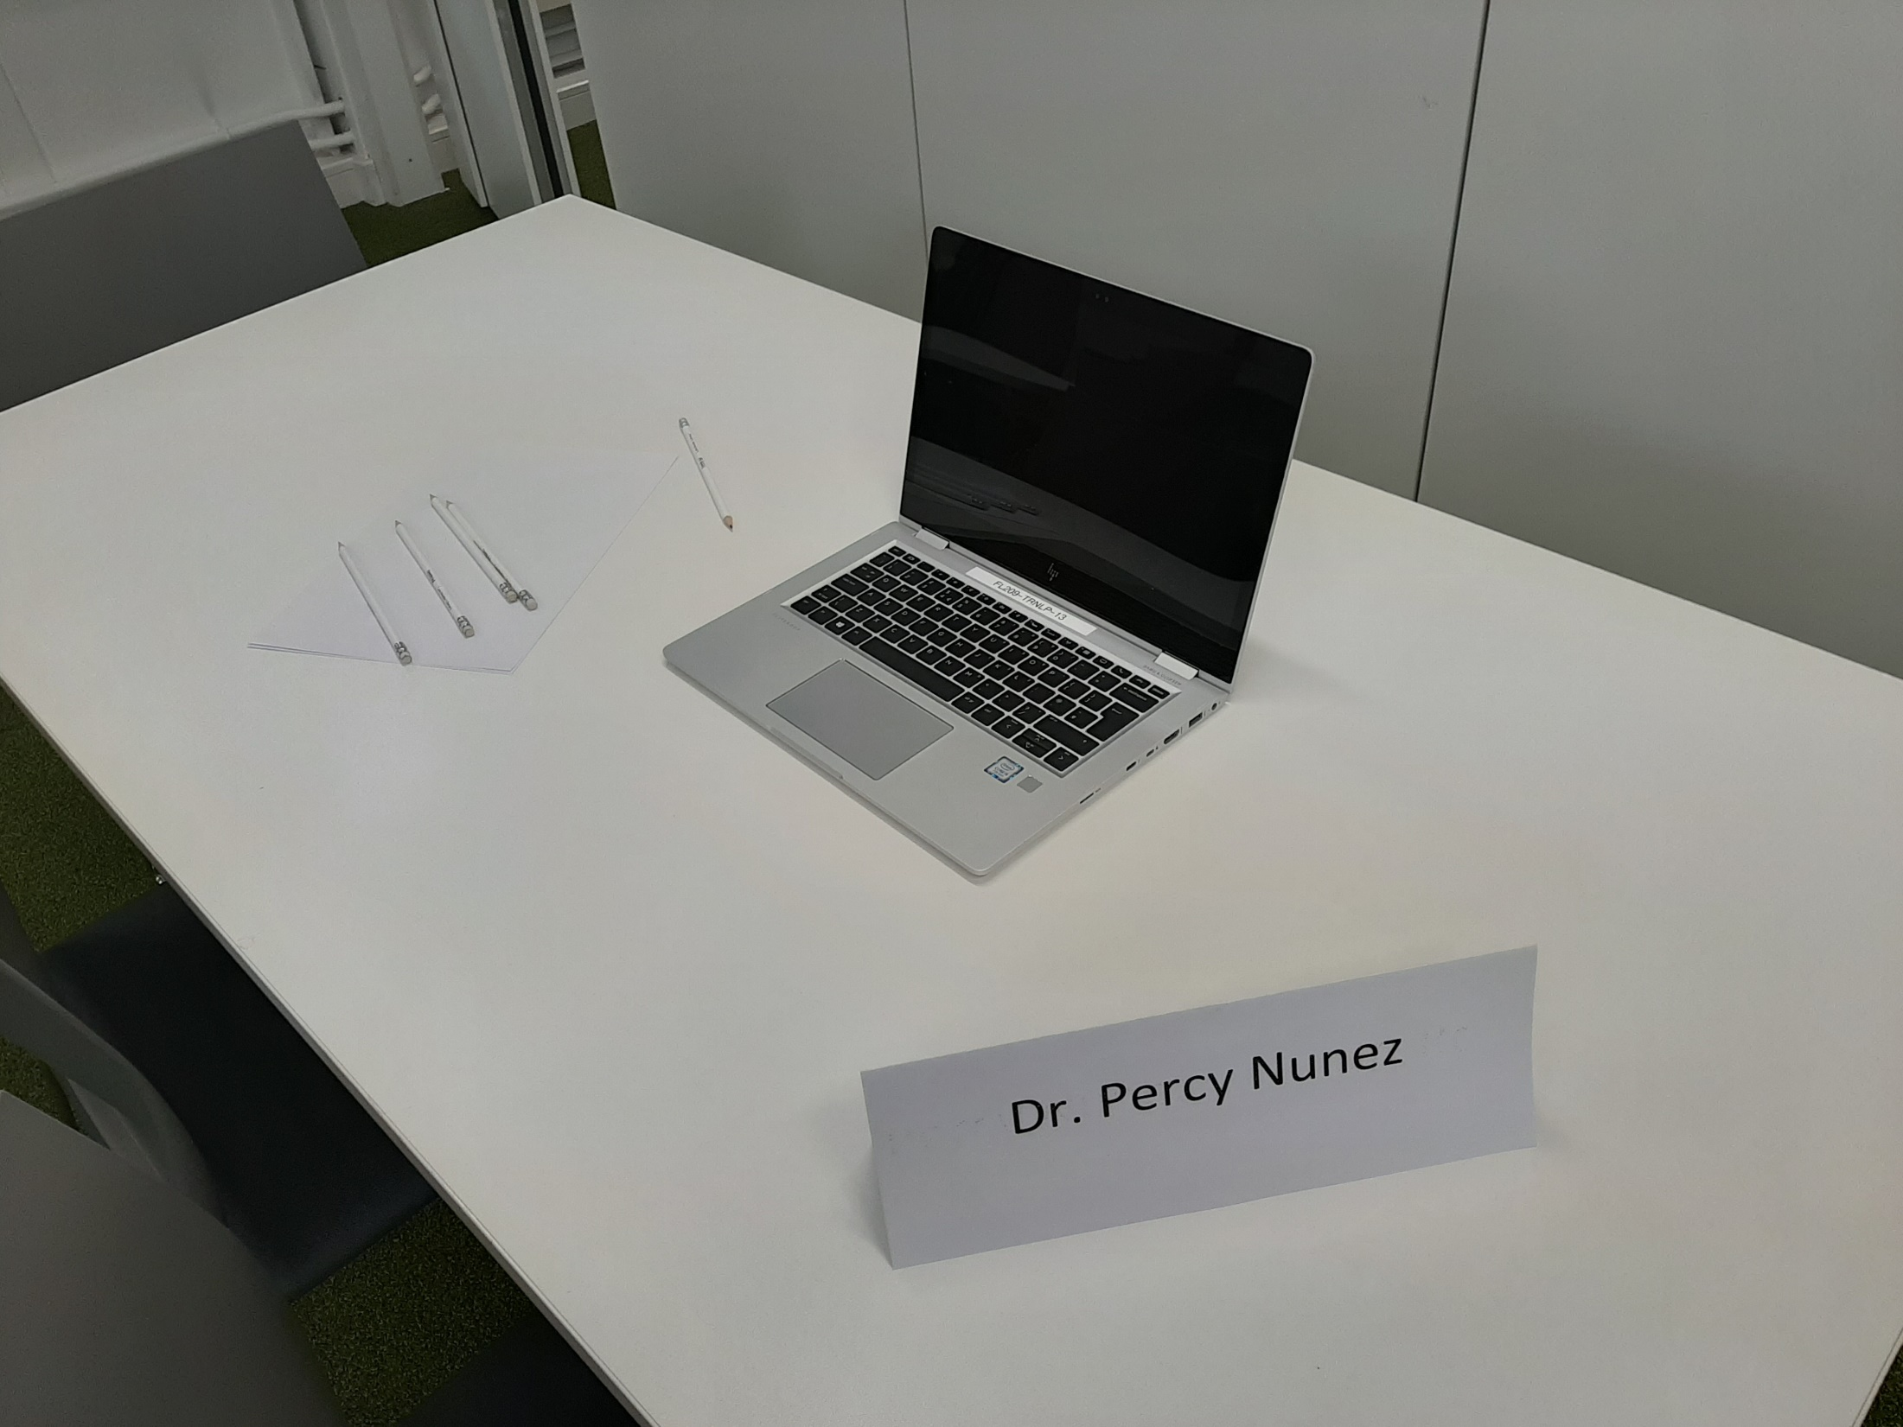
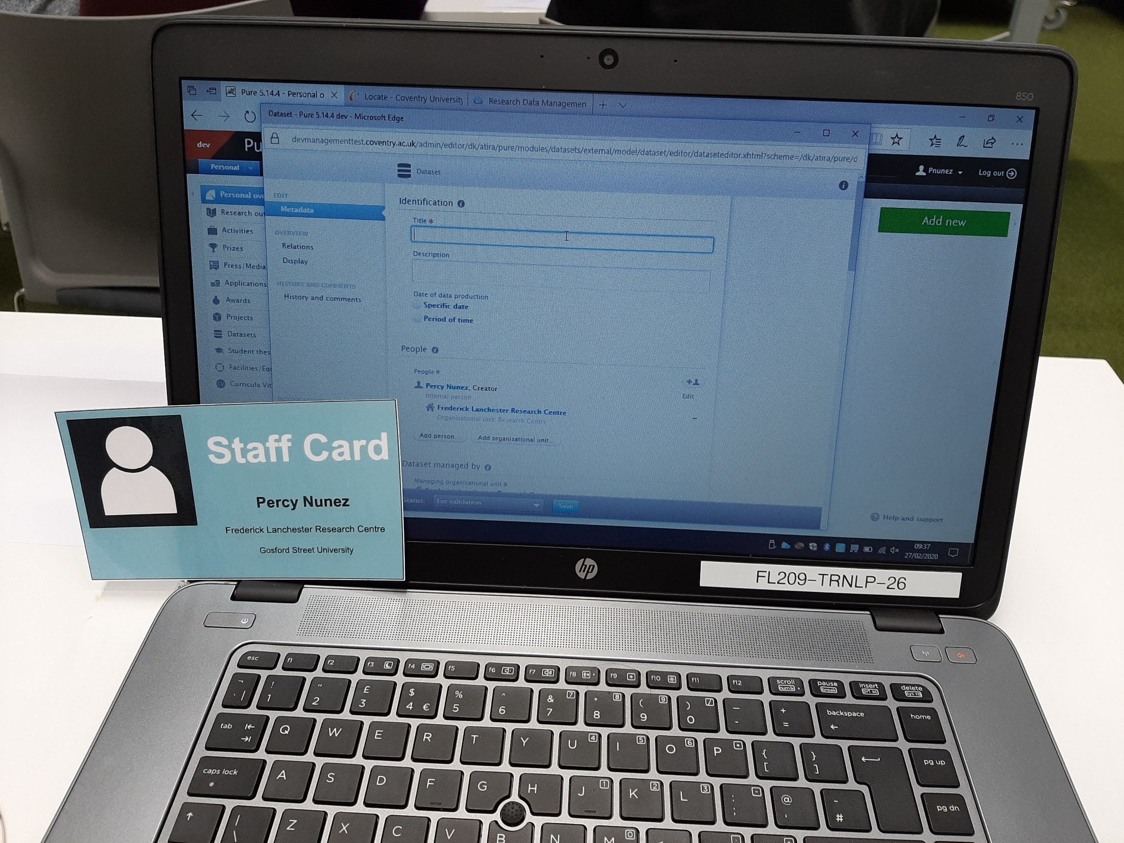
Testing of the activity
Trial run
Pure Manager Research and Scholarly Publications Team colleagues

Slide 13
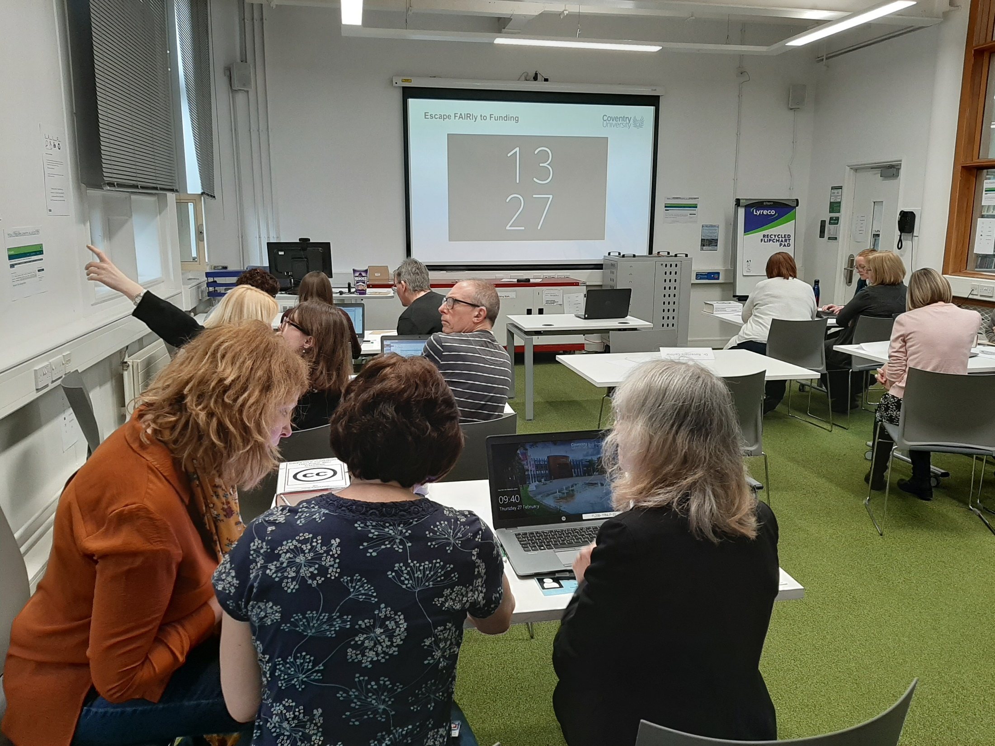
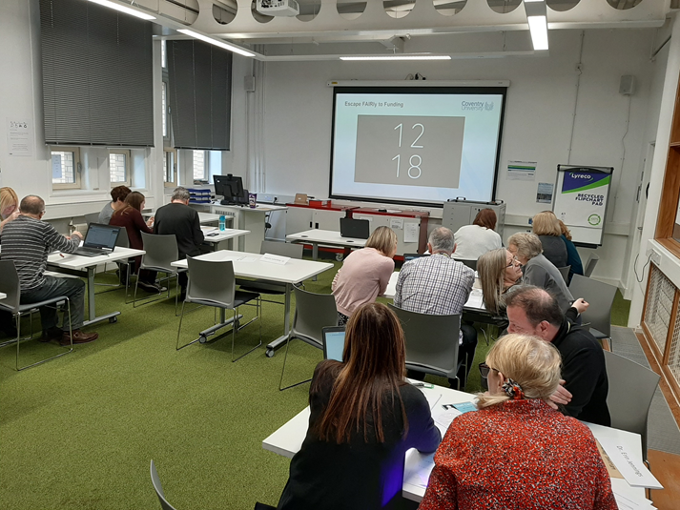
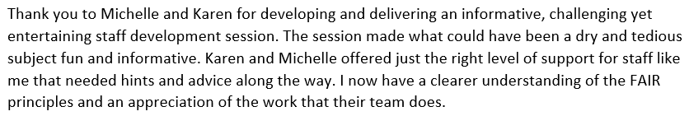
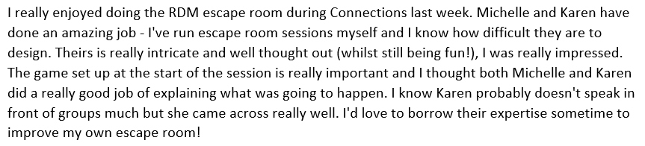
First run of the activity
Library Staff Development Time
Colleagues arranged into teams (chance to mix with other departments). Each team played as a researcher of the fictitious university research centre. Friendly competition between each other. Received good feedback!

Slide 14
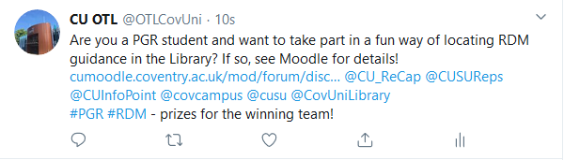
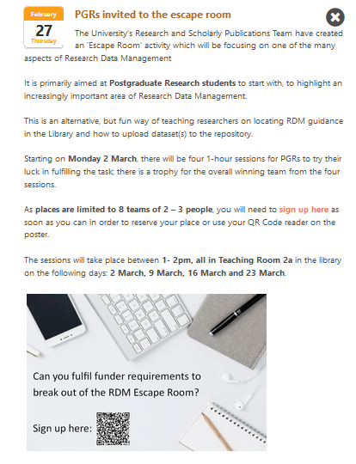
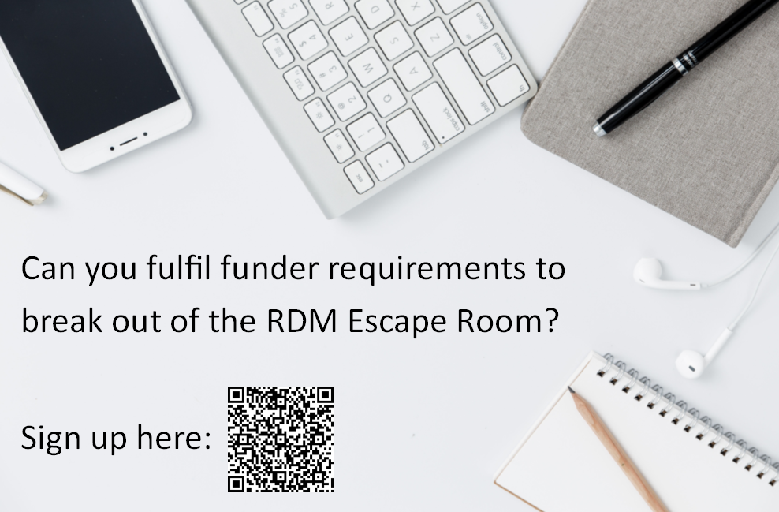
Promotion of the activity
Getting the word out...
CU internal communications Moodle news feed Yammer Student portal Library screens Twitter MS Forms url link

Slide 15
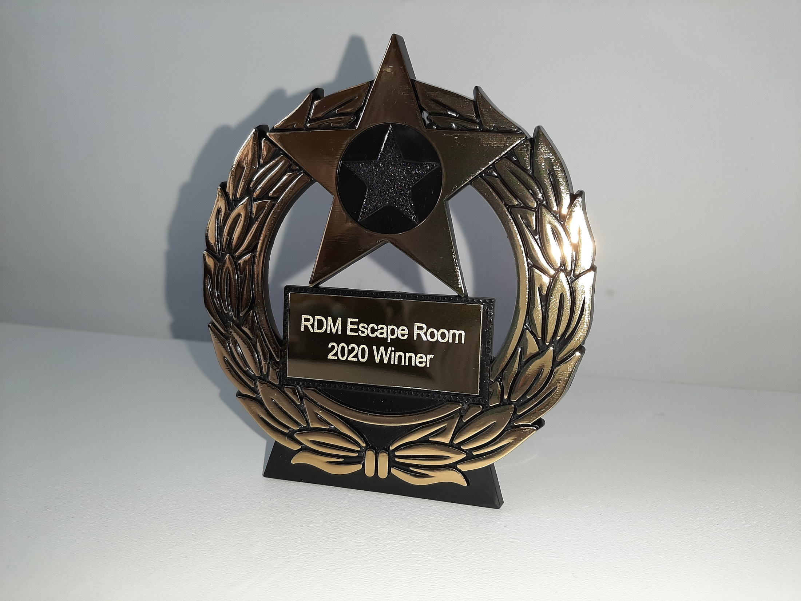
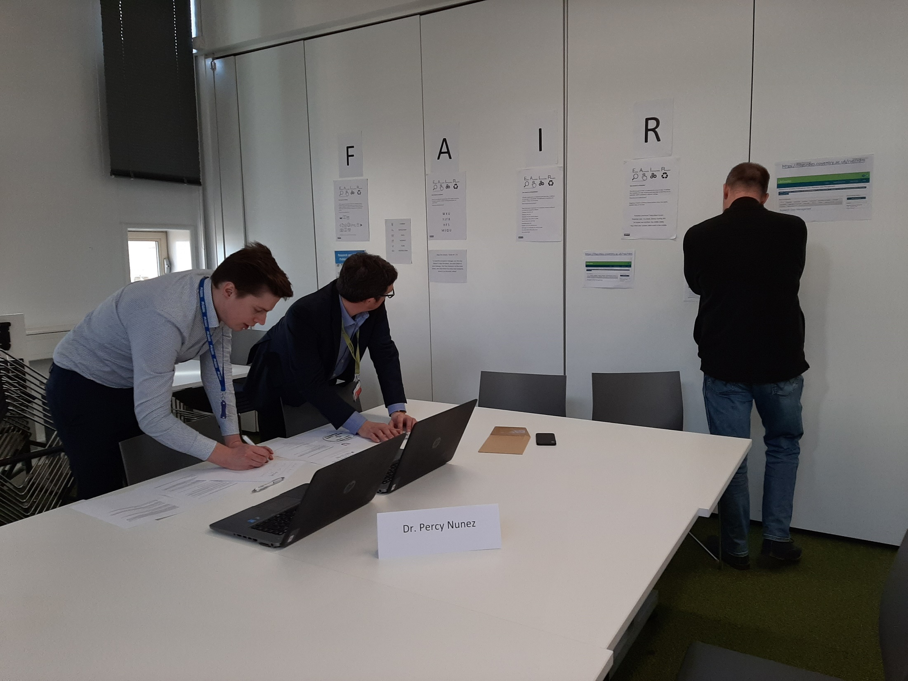
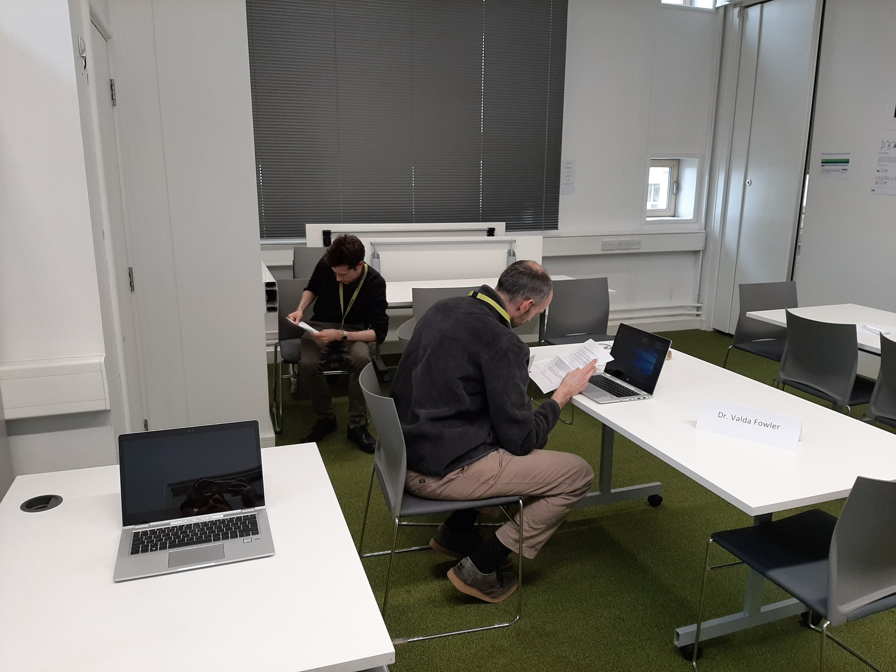
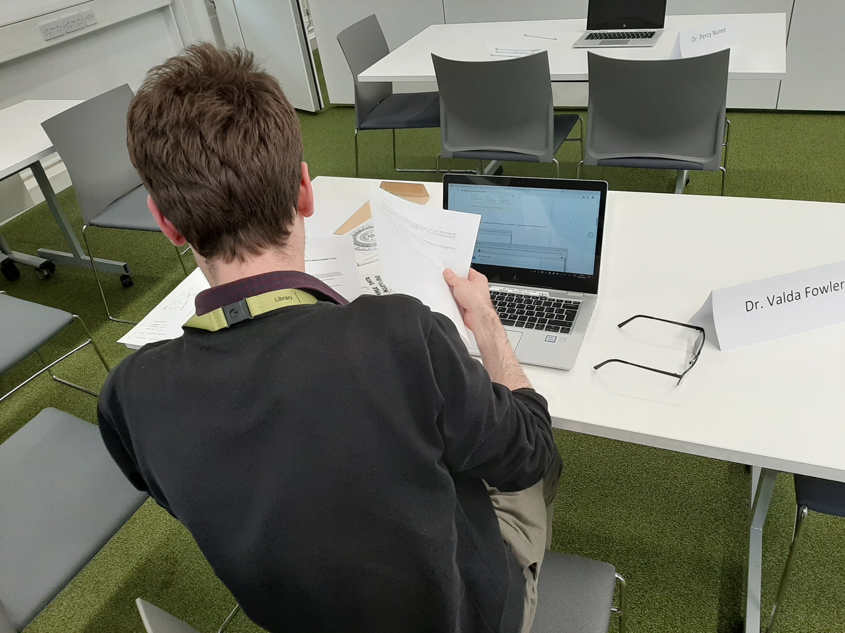
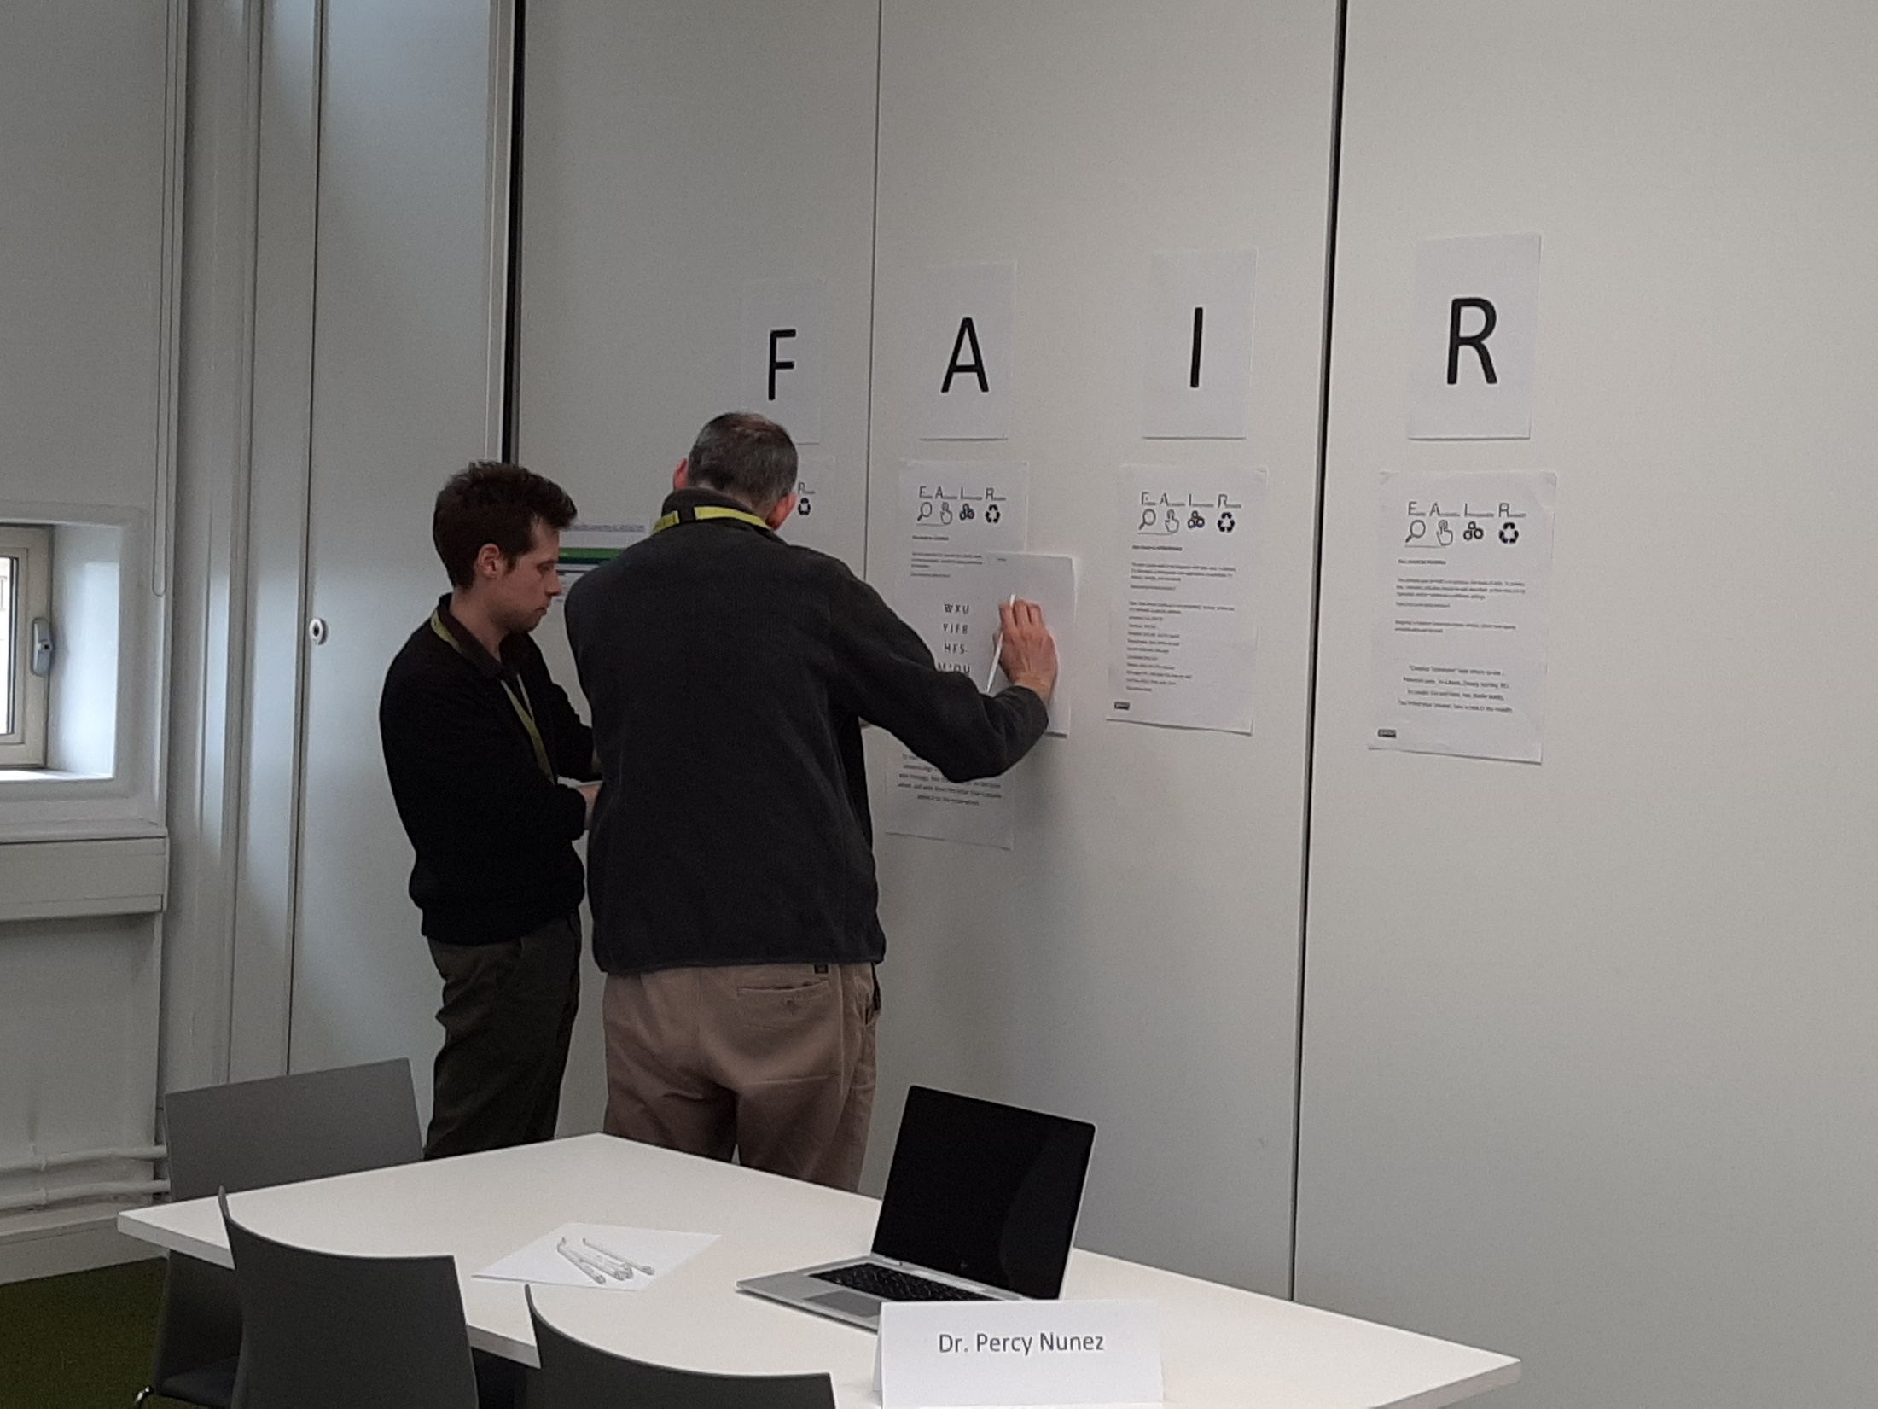
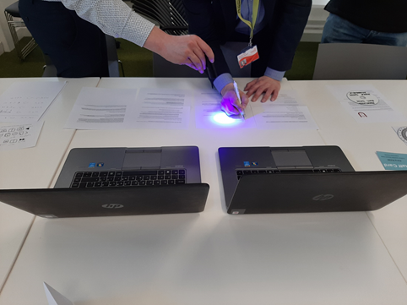
Competition Time

Slide 16

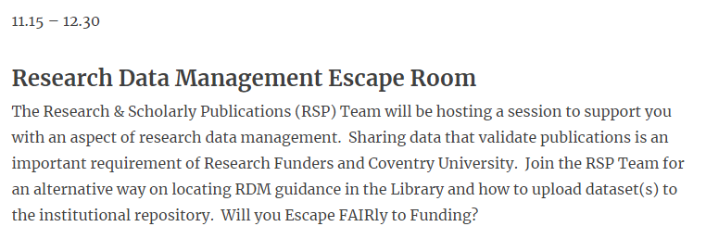
Research Hootenanny 2022
January 2022
Fewer attendees than usual. Two PGR teams from Arts and Humanities. Competition between friends. Positive verbal feedback.
Notes:
Coventry University Research Hootenanny
a vibrant mix of activities to showcase research excellence at CU,
to celebrate our researchers’ successes and to explore new ways to undertake, and
to share research – locally, nationally and internationally.

Slide 17
What next?
Where to go from here…
Virtual adaptation of the activity Create more interactive sessions: Same format? Something else?

Slide 18
Thank you!

