Slide 1
Library Engagement through School-based committee meetings
Steve Bull
Library Engagement Advisor
September, 2022

Slide 2
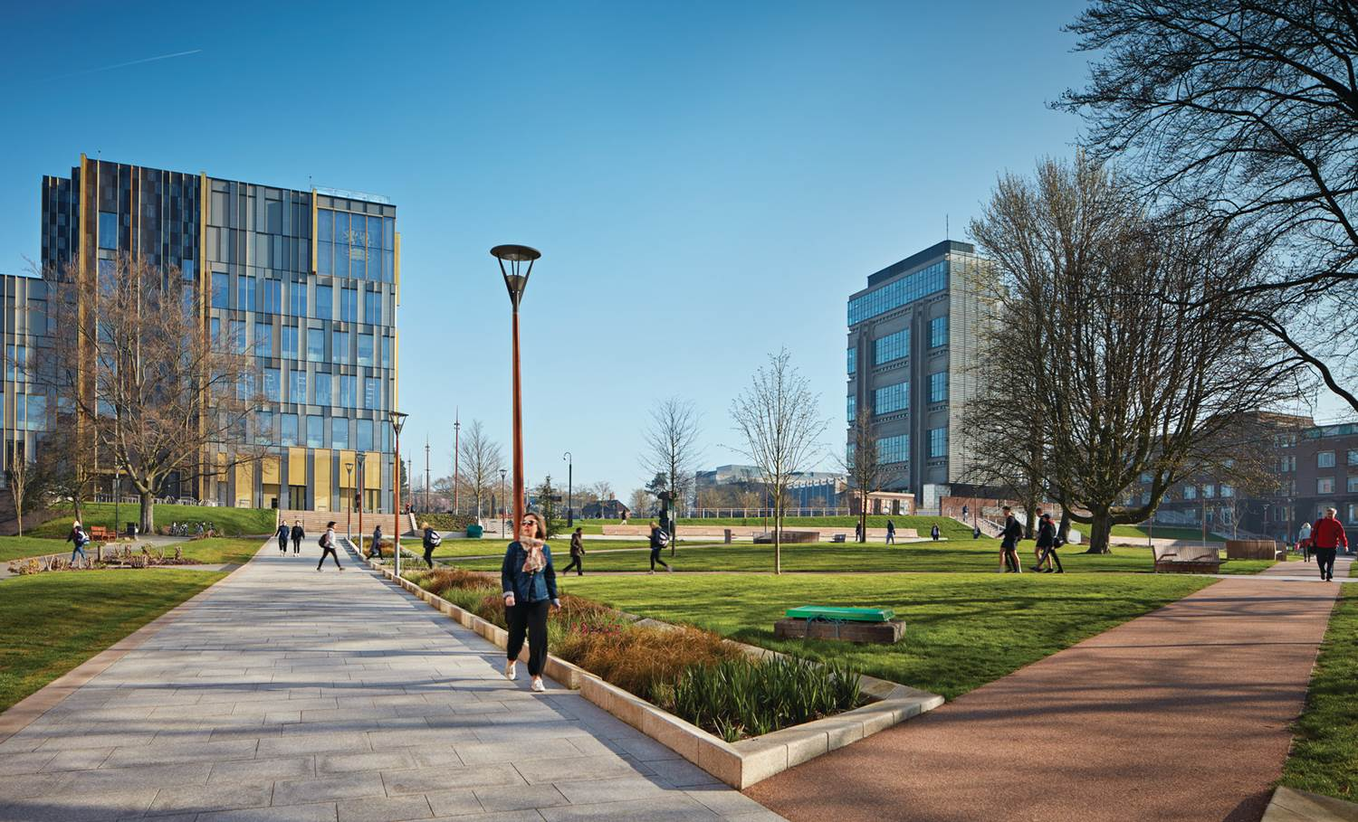
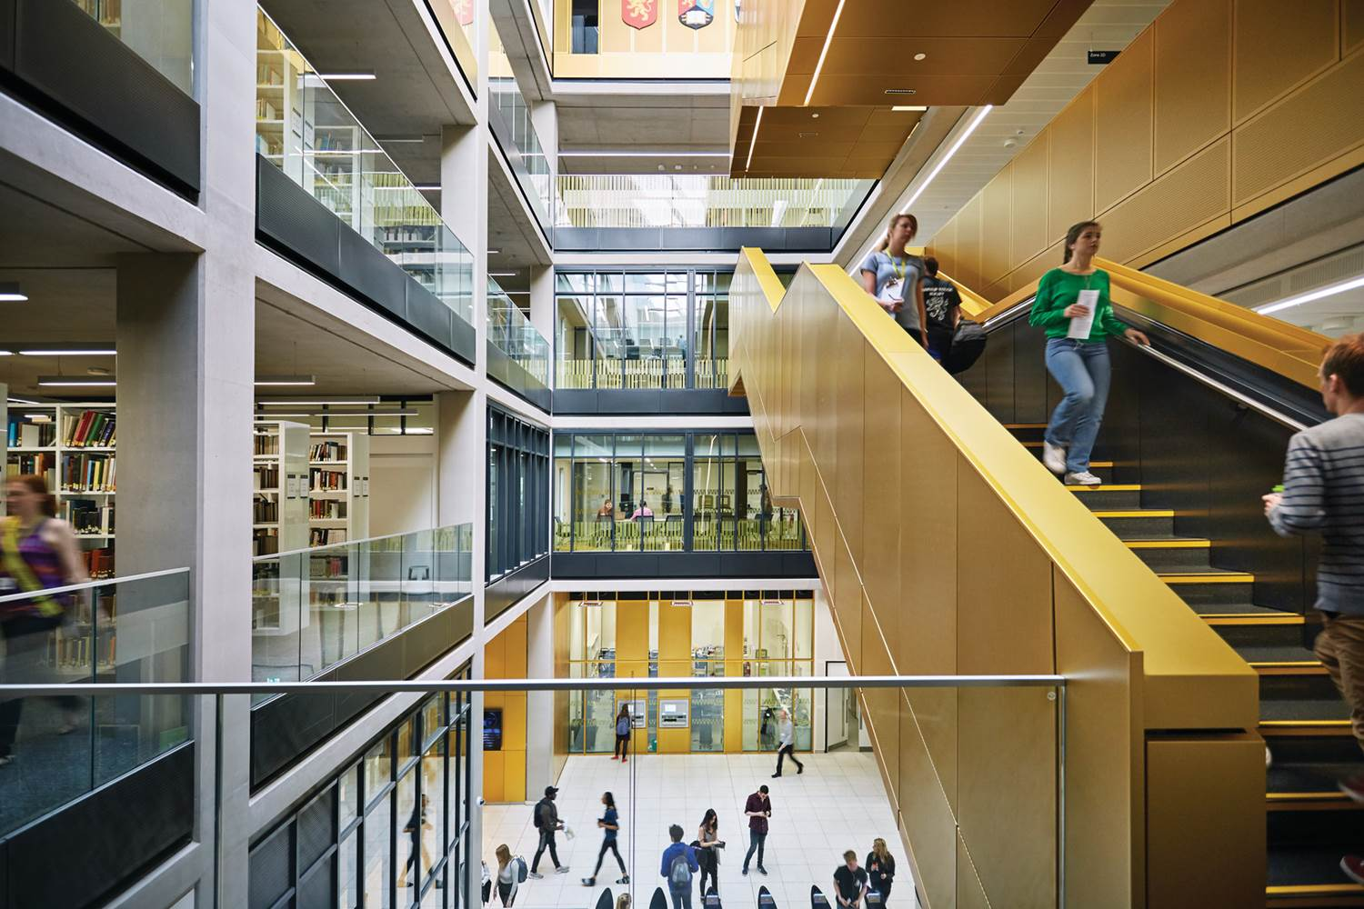
A little about us…
University of Birmingham
Arts and Law (CAL)
Engineering and Physical Sciences (EPS)
Life and Environmental Sciences (LES)
Medical and Dental Sciences (MDS)
Social Sciences (CoSS)

Slide 3
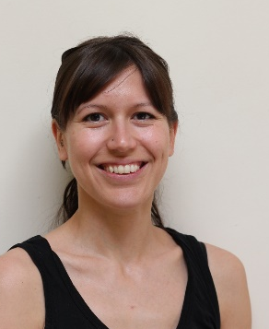
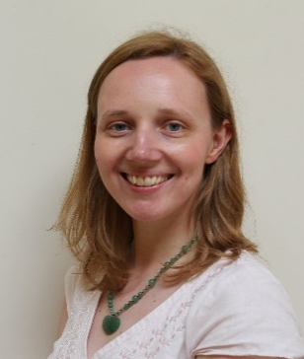
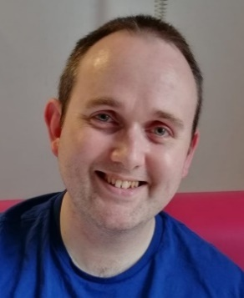
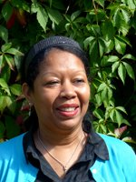
The Library Engagement Team
Work strategically with Schools to support their teaching and research agendas
Represent Library Services at Staff Student Forums (SSFs) and Education Committee
Coordinate & disseminate service-wide student/academic comms
Optimise the resources needed by Schools
Second-level support on using ResourceLists@Bham

Slide 4
Staff Student Forums (SSFs)
135
UoB SSFs
Student Reps, Academic & Professional Services staff
Represent Library Services at SSFs:
Disseminate relevant ways Library Services can support staff/students
Gather business intelligence and staff/student feedback
3
times per year most SSFs meet
72%
of SSFs attended by Library Services
1
time per year library ‘must’ be invited
165
SSFs attended in 2021-22

Slide 5
Education Committees (ECs)
Attend College & School Education Committees
Membership includes: HoE, Programme Team Lead, Programme Directors, Year Leads, Student Reps, Student Experience Officers
Focusses on education and curriculum development
Two way conversation as per SSFs
4
CECs sat on by Library Services
3-5
times per year most ECs meet
23
SECs sat on by Library Services

Slide 6
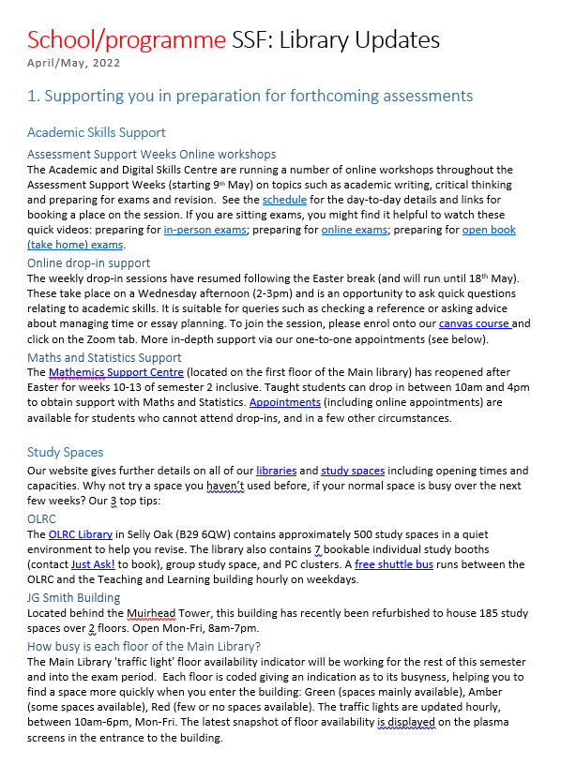
Streamlining information dissemination
Report templates
Consistent service-wide messaging
Efficiency
SSF and EC templates
Updated 4-5 times per year
Can be circulated with paperwork
Adapt to the audience and time available

Slide 7
Reporting business intelligence internally
Library-related feedback
Etextbooks / Resource Lists
Physical space
Things resulting from our report
Via MS Teams
Key points available cross-service
Can tag colleagues in
Colleagues can respond efficiently
Non-library-related intelligence
New programmes or modules
Admissions
Things of concern to student cohorts
New initiatives / areas of focus
Professional Services updates

Slide 8
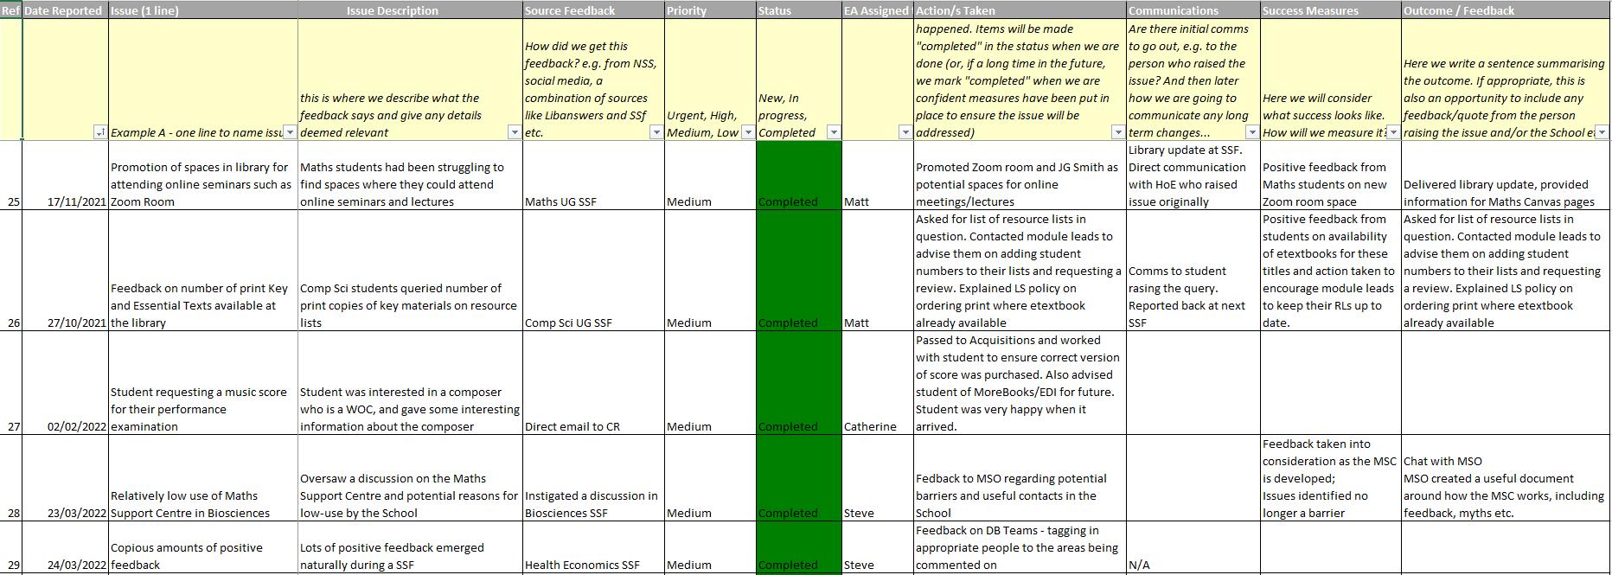
Acting upon feedback
Tracking actions
Working document; assigns responsibility; defines what success looks like; reports on outcome

Slide 9
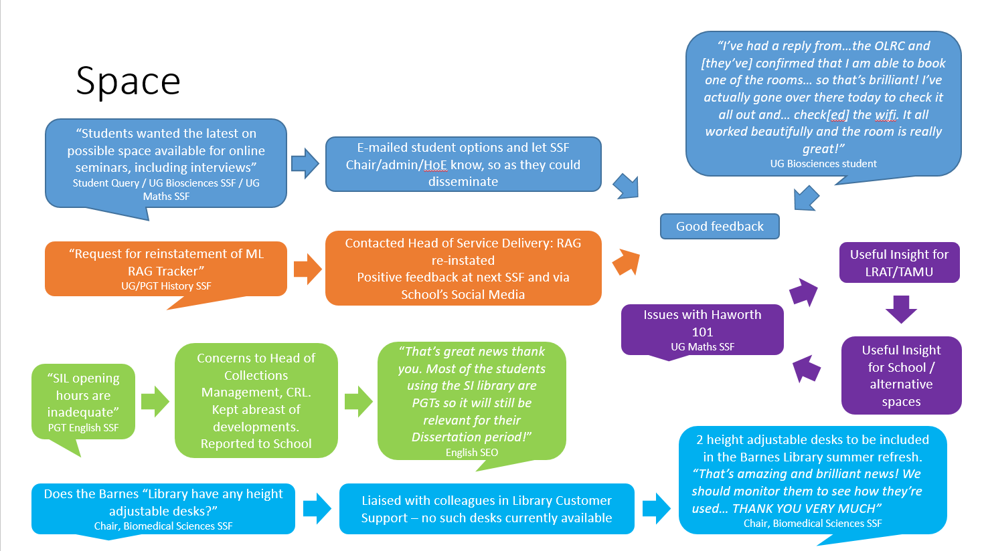
Closing the feedback loop
Internally
Summarise termly to Library Services Executive Group
Externally
At next meeting
By e-mail
Via wider comms

Slide 10
Our engagement feedback loop
Attend SSF/EC
Gain Business Intelligence
Feed into Service Development
Proactively follow-up on actions
Measure impact

Slide 11
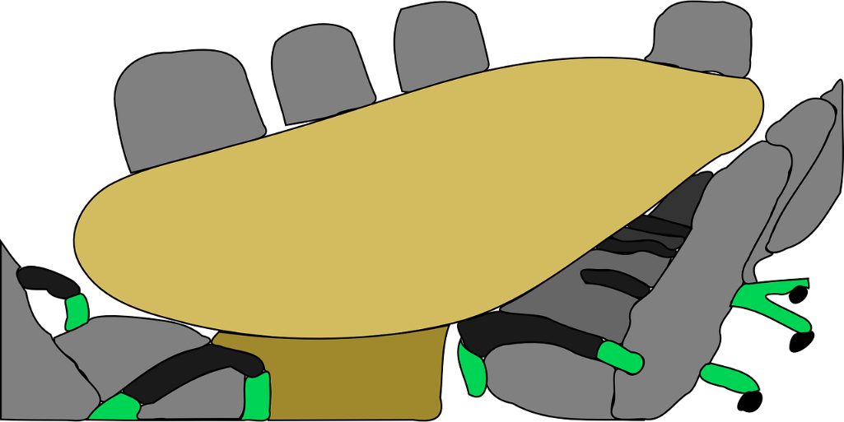
5 Top tips

Slide 12
Thank you and any questions
s.a.bull@bham.ac.uk

